Slide 1
@tristanls
Notes:
Hi, my name is Tristan Slominski and you can find me as @tristanls on things like twitter, github, and others…

Slide 2
REMINDER:
Notes:
I want to highlight something before we start...

Slide 3
REMINDER:
you may find yourself wondering what this has to do with JavaScript…
Notes:
We are going to get into some things that may be unfamiliar...

Slide 4
REMINDER:
you may find yourself wondering what this has to do with JavaScript…
all of what follows has been implemented in JavaScript

Slide 5
REMINDER:
you may find yourself wondering what this has to do with JavaScript…
all of what follows has been implemented in JavaScript
these are tools YOU can use tomorrow

Slide 6
let’s build an app
Notes:
So, let’s build an app...

Slide 7

Notes:
We get our “Hello World!” up and running, it’s light, agile, and can accomplish pretty much nothing useful...
http://silodrome.com/wp-content/uploads/2012/02/jumping-jeep1.jpg

Slide 8
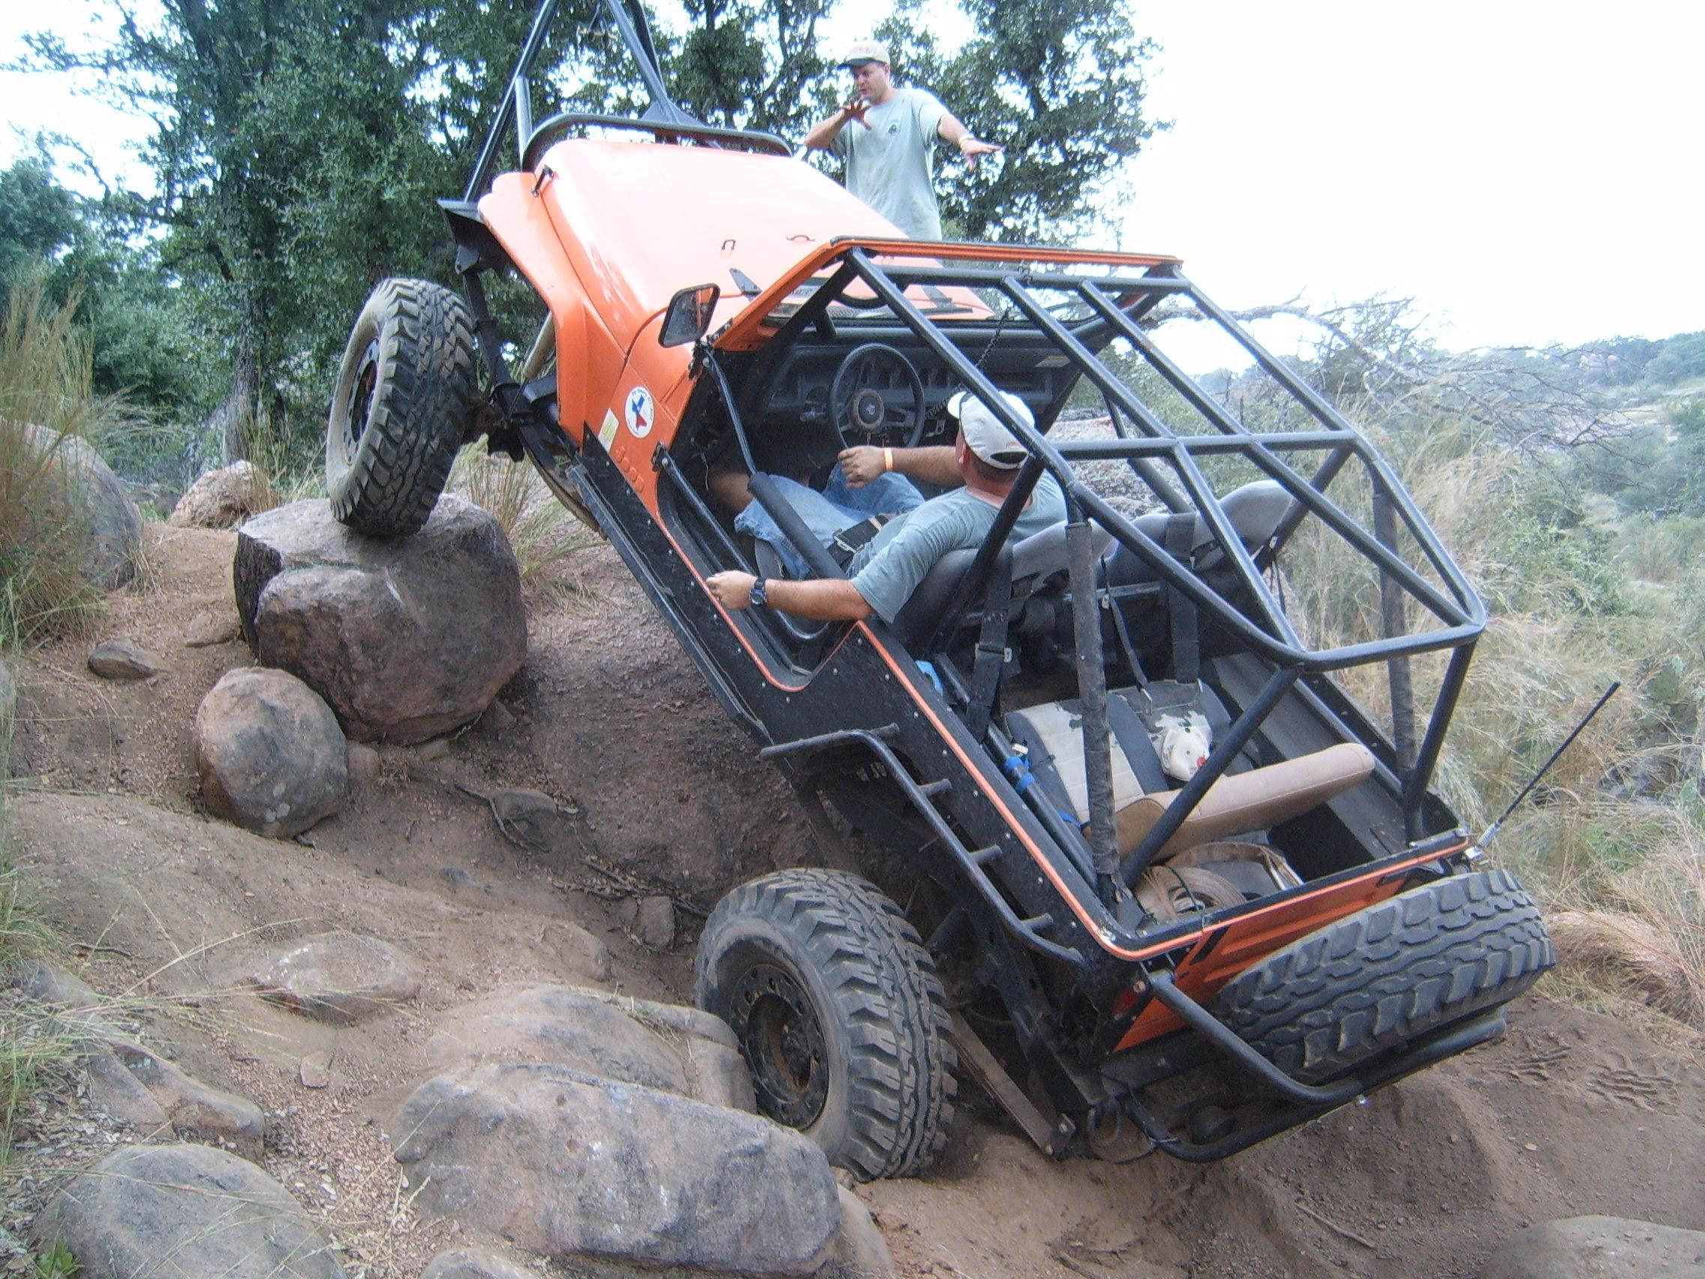
Notes:
We then need to actually do some things with the app, so we expand the team a bit, and start carefully guiding our application through the features we need...
http://thejeep.org/wp-content/uploads/2011/08/off-road-jeep-yj.jpg

Slide 9

Notes:
It get’s a little harder as we go, we add some customization to the tools we use to make them useful for our particular problem domain, we specialize a bit...
http://moabdave.files.wordpress.com/2013/05/dscn0108.jpg

Slide 10
a few features later...

Slide 11
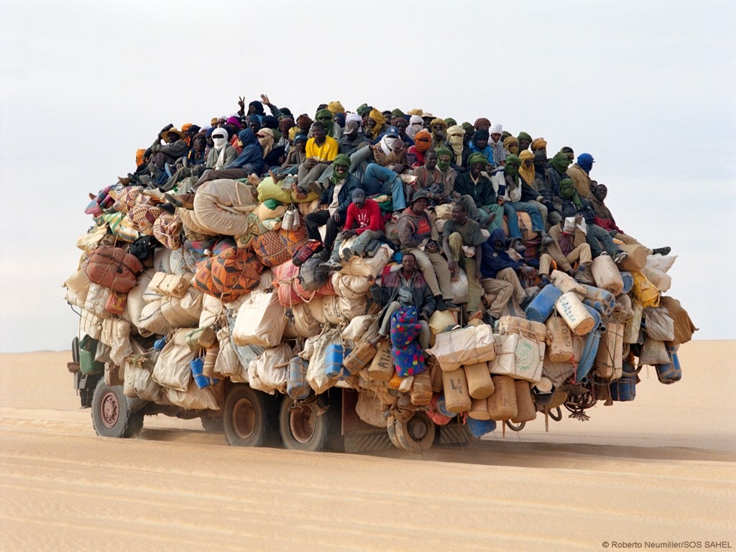
Notes:
And we get this… More users arrive...
http://worldsupertravel.com/wp-content/uploads/2011/08/overloaded_truck_africa.jpg

Slide 12
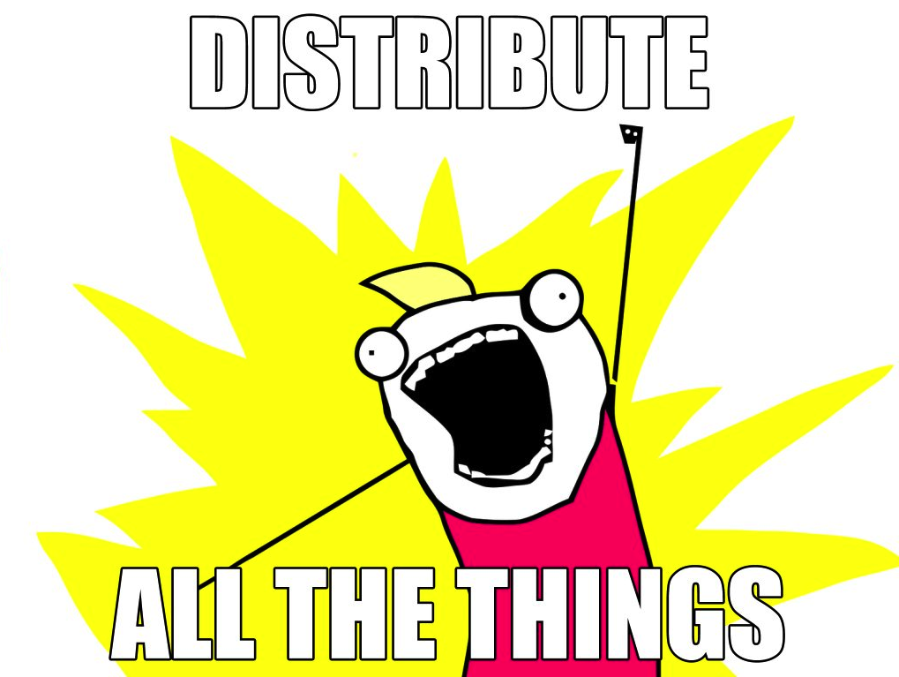

Slide 13
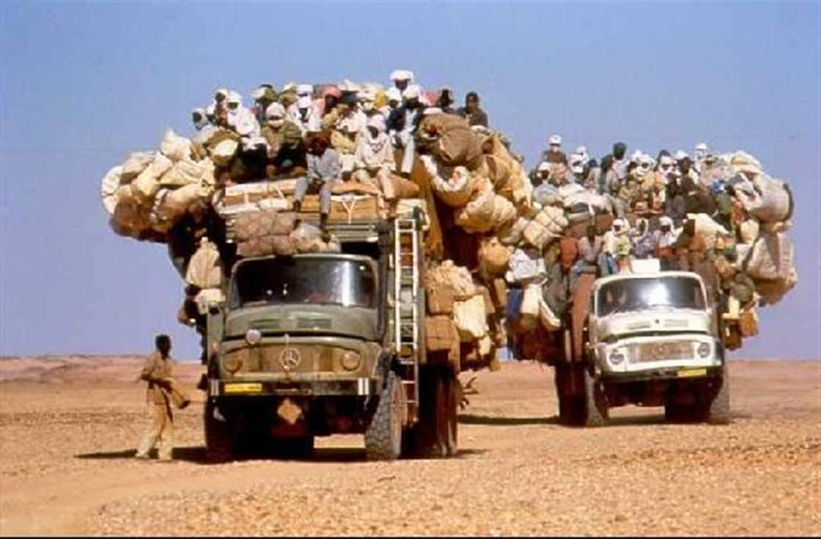
Notes:
So, we distribute...
http://puntito131.puntopressllc.netdna-cdn.com/wp-content/uploads/2012/01/libyatoday-transport_libya.jpg

Slide 14

Notes:
http://cdn.alltheragefaces.com/img/faces/large/misc-clean-all-the-things2-l.png

Slide 15
that’s not distribution

Slide 16
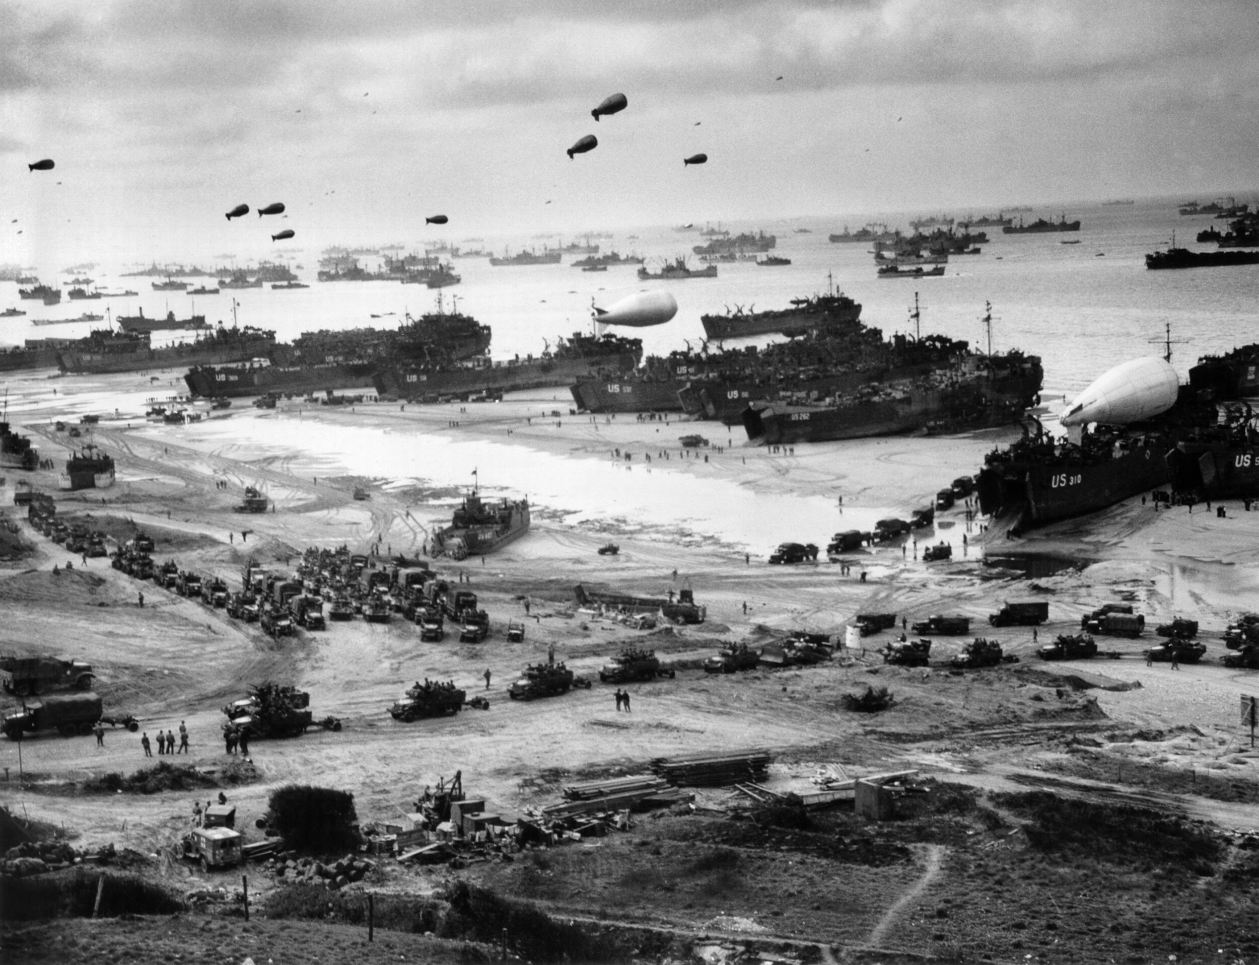
Notes:
A far cry from our hello world example… we can think of this as what some of the Internet giants have in production… but it requires an insane amount of planning, resources, and coordination to execute… failure here is possible, but not expected
But, can we do without centralized coordination? What happens when failure is expected rather than simply possible?
http://upload.wikimedia.org/wikipedia/commons/6/66/NormandySupply_edit.jpg

Slide 17
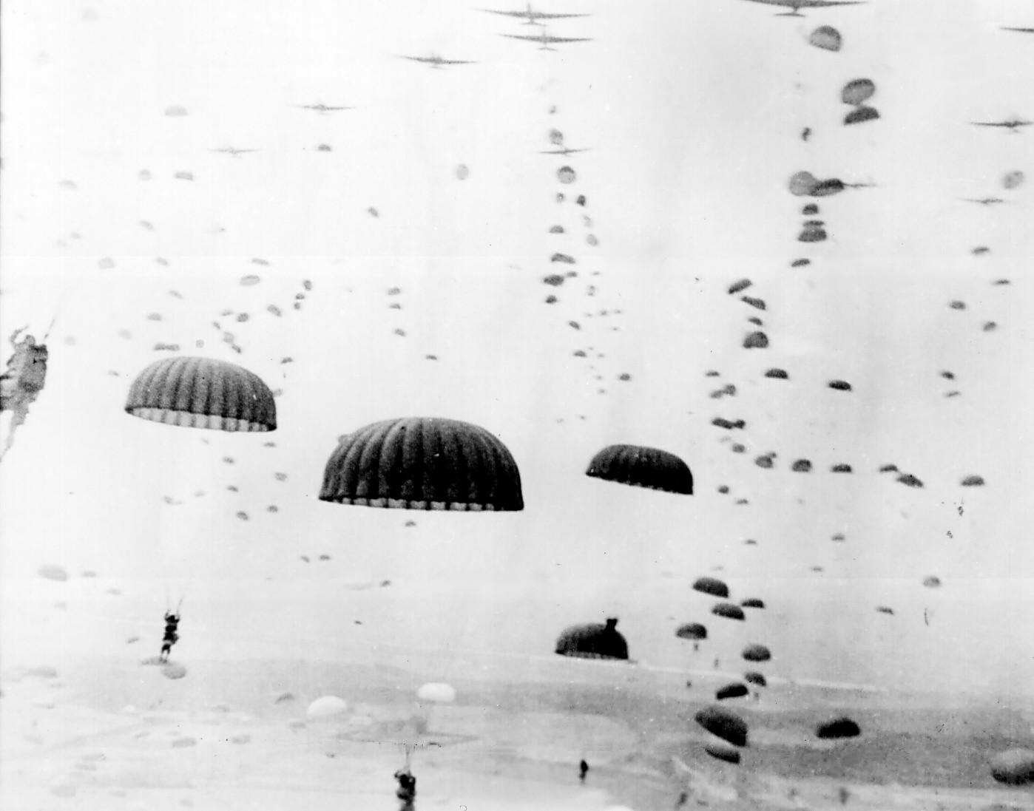
Notes:
In preparation for the beach Normandy landings, airborne troopers were dropped behind enemy lines. Despite an existing hierarchy of military ranks, every soldier knew the objectives and the mission of the unit he was in. Failure was expected. Due to numerous factors they dropped all over the place, sometimes far away from where they were supposed to be, yet they were able to coalesce together into groups of various sizes and capability and accomplish their mission.
When failure is expected, distribution is the only way to accomplish something.
http://upload.wikimedia.org/wikipedia/commons/9/9a/Waves_of_paratroops_land_in_Holland.jpg

Slide 18
but I will never...
Notes:
We may think that we will never have to create applications where failure is expected and where a vast amount of resources is necessary to distribute and orchestrate everything… yes, that may be true. The use case simply doesn’t apply to us.

Slide 19
ok, but let’s not stop just yet
Notes:
But this is usually where we stop. What happens if we keep pursuing distribution beyond this point? Can it lead to something that we could use in our smaller applications?

Slide 20
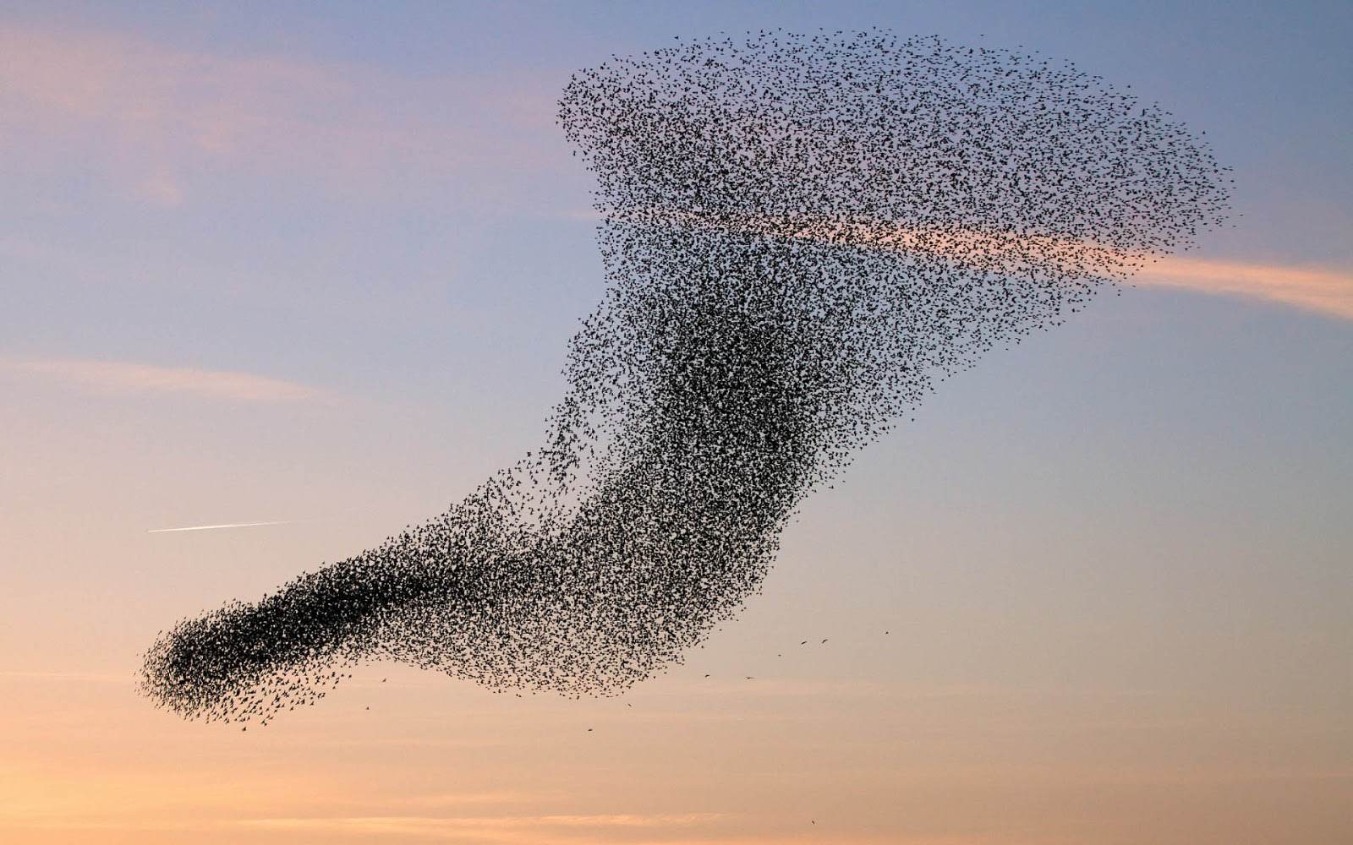
Notes:
What happens when the boundary between an individual entity and the collective becomes blurred?
http://www.photoinpixel.com/mypicture/flock-of-flying-birds-desktop-wallpaper.jpg

Slide 21
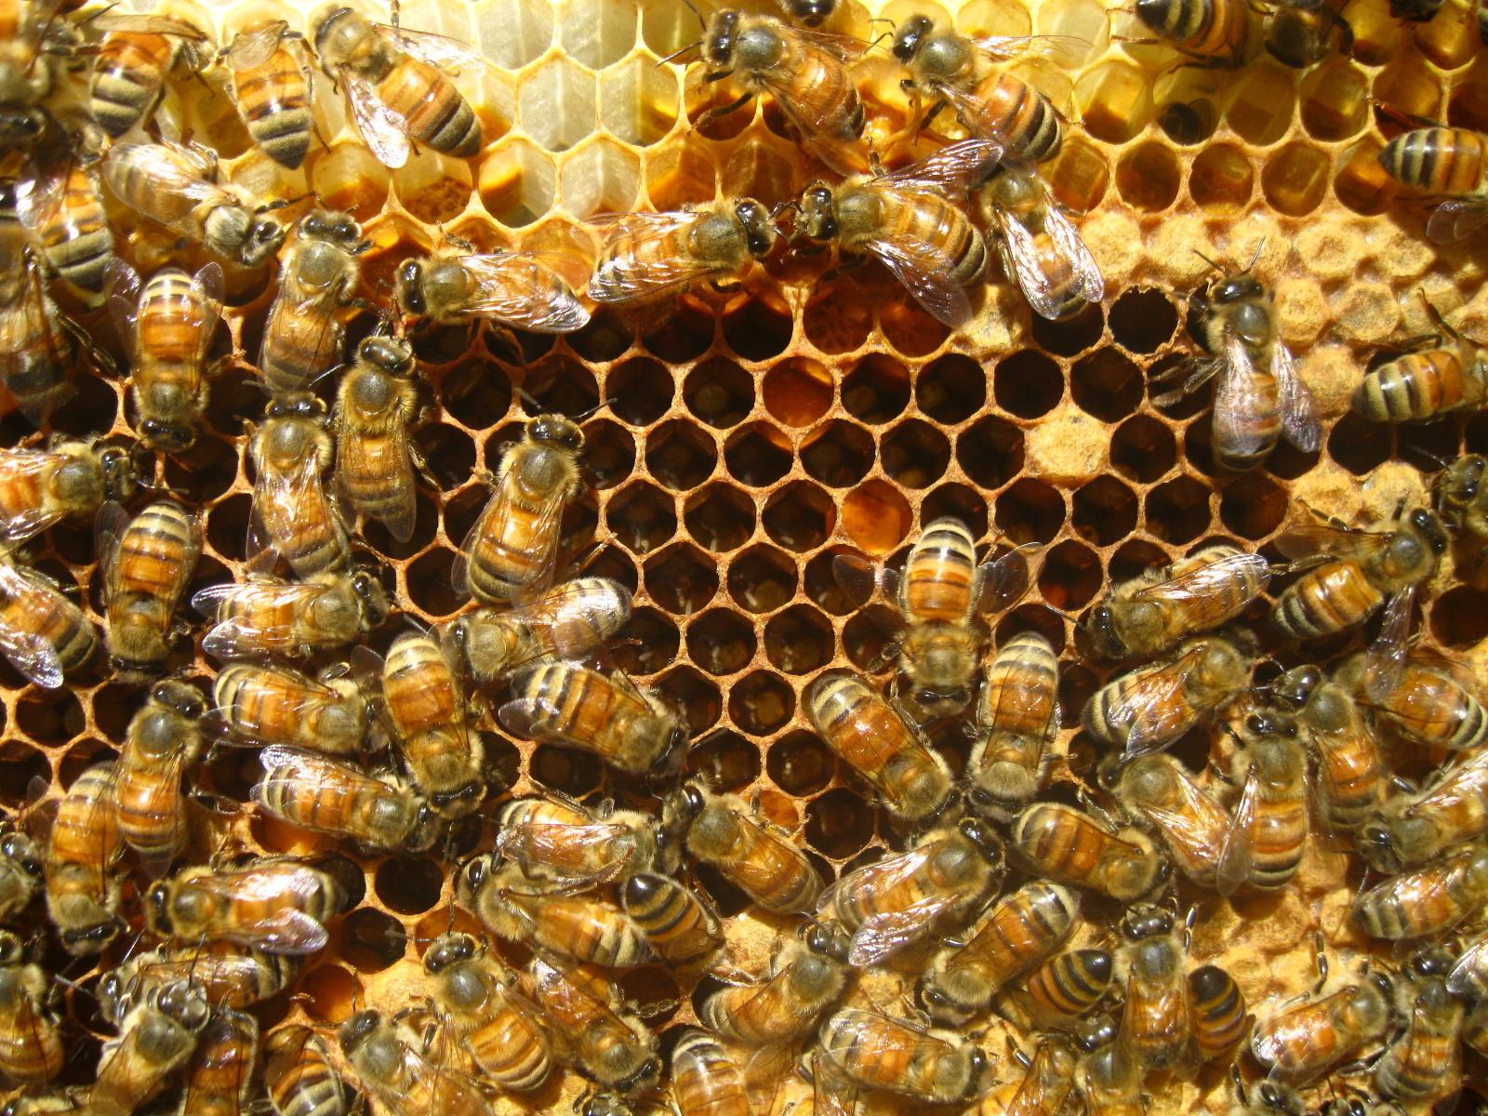
Notes:
http://4.bp.blogspot.com/-_sNxIqhxDGY/TgfEPc-ljbI/AAAAAAAA4aw/gUXruv2Ejz8/s1600/AprilBEE%2B030.jpg

Slide 22
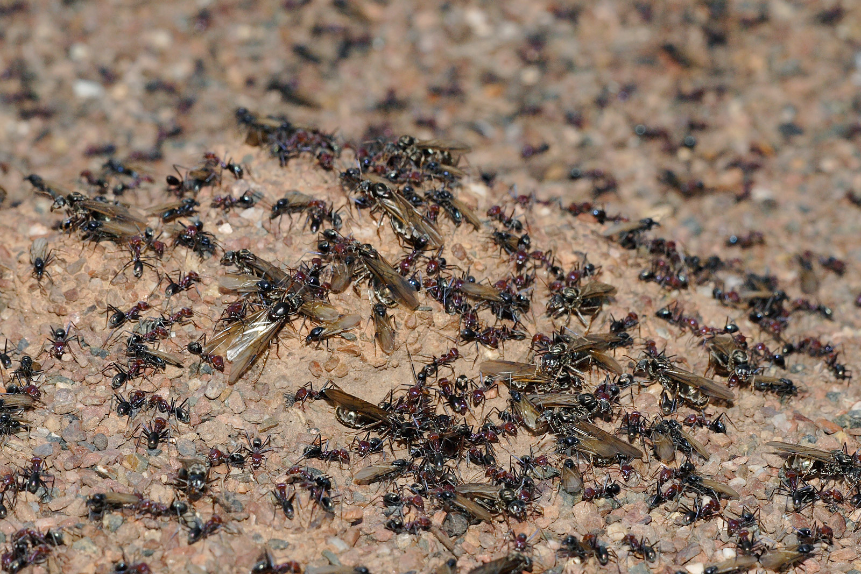
Notes:
contrary to “Ender’s Game” (out in theaters), the queen does nothing special to coordinate behavior of an ant colony.. the colony behavior is an emergent property…
these are all examples of (mostly) the same individual entity aggregated into a collective where the whole is greater than the sum of the parts...
And if we’re familiar with this emergent behavior and systems that can be built this way, this is where we usually stop..
http://upload.wikimedia.org/wikipedia/commons/e/ef/Meat_eater_ant_nest_swarming03.jpg

Slide 23
can we go farther?

Slide 24
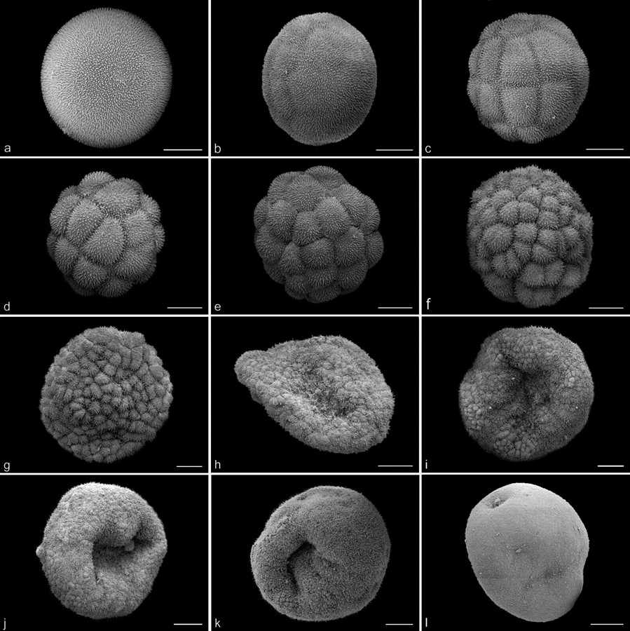
Notes:
this is a picture of the stages in development of a Host Sea Anemones embryo, from a single cell at the top left to a larva at the bottom right
http://www.biolbull.org/content/213/2/110/F4.large.jpg

Slide 25
can we build systems that build themselves?

Slide 26
why?

Slide 27
why?
Notes:
this is not a “why” talk...

Slide 28
why not?
Notes:
this talk is about “why not?”, and I hope you’ll find some tools here you could use in the applications you build tomorrow
but first, let’s consider some common objections...

Slide 29
well… what about control?
Notes:
The first thing that comes up when discussing distributed systems with emergent behavior is “control”. We feel we need to be able to control our creations…

Slide 30
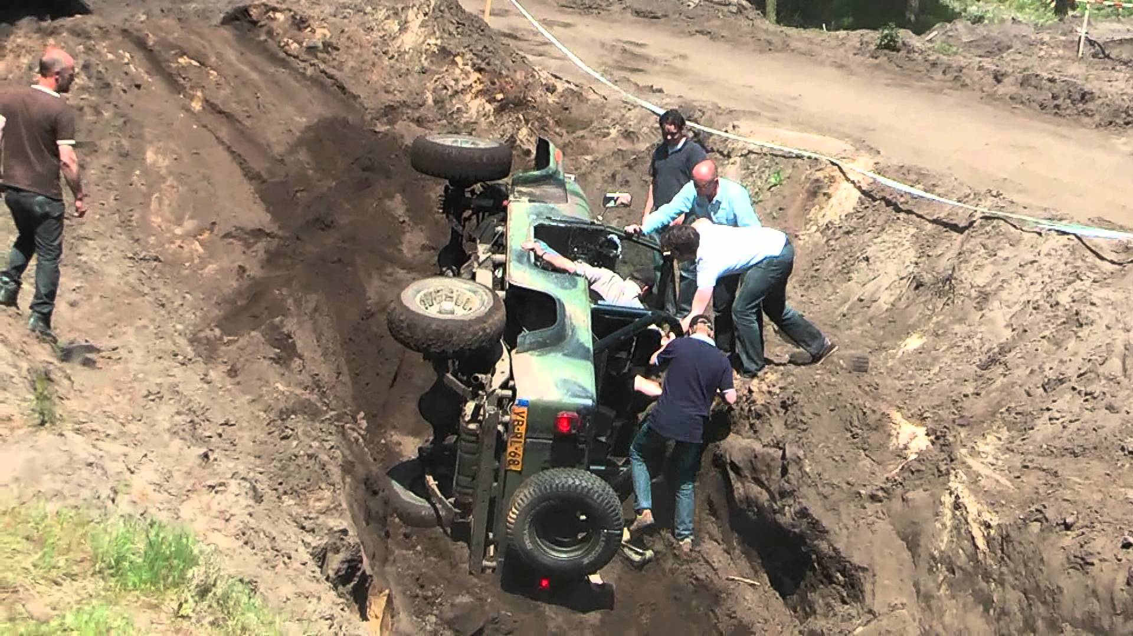
Notes:
If we only control our systems carefully, nothing bad will possibly happen..
these systems only become as good as the worst operator...
http://i1.ytimg.com/vi/wMa8jbQYNMw/maxresdefault.jpg

Slide 31
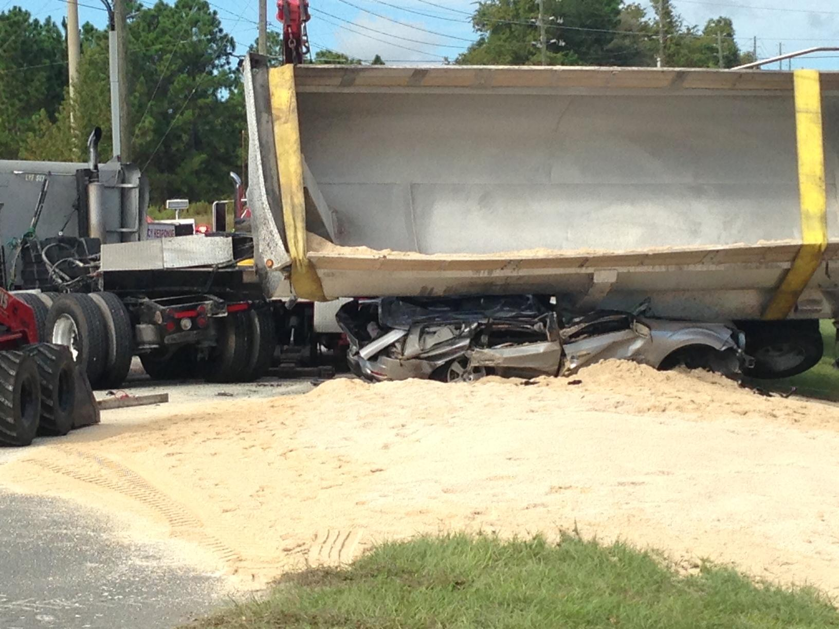
Notes:
worse yet, sometimes the operator can do nothing...
http://baynews9.com/content/dam/news/images/2013/10/semi-truck-and-car-crash-clermont-3-100413.JPG

Slide 32

Notes:
I believe that this type of control is an illusion, a deeply ingrained illusion, but an illusion nevertheless..
What I think we typically want is not control, but invariants...
http://i1.ytimg.com/vi/UxqjltSLiUo/maxresdefault.jpg

Slide 33
invariants
Notes:
a function, quantity, or property that remains unchanged when a specified transformation is applied.
things that don’t change…
i will present some distributed patterns that give us control in terms of emergent invariants...

Slide 34
but… distributed computing is hard
Notes:
but… distributed computing is hard...
yes, there is a lot to getting distributed systems right...

Slide 35
the network is reliable
latency isn’t a problem
bandwidth isn’t a problem
the network is secure
topology won’t change
the administrator will know what to do
transport cost isn’t a problem
the network is homogeneous
the system is atomic/monolithic
the system is finished
business logic can and should be centralized
Notes:
for example, here are is a list of fallacies of distributed computing… we need to get all of this right to succeed...

Slide 36

unfamiliar ≠ hard
Notes:
however, i think “hard” is not the right word for this. I prefer “unfamiliar”. We are born as individuals… and we are mentally equipped to form tribal societies reaching up to somewhere around the Dunbar number, which is around 150 individuals. After that, we are literally not equipped to maintain a social network beyond that size. We need abstraction to help us reason about distributed systems with thousands of nodes beyond the 150 we can reason about. As I hope to demonstrate, these abstractions are not hard in and of themselves. But they are unfamiliar, alien even.
Becoming familiar with these should greatly simplify in how we think about and arrange distributed systems and allow us to realize the benefits of decentralization.
http://www.geriatriccaremanagement.com/wp-content/uploads/2011/07/head-in-the-sand1.jpg

Slide 37
what about
premature optimization?
Notes:
I often come across the attitude that distributing and decentralizing is a premature optimization. YAGNI :/
I now believe that “premature optimization” is one of those phrases to which any meaning can be given.

Slide 38
Notes:
What is premature optimization in this system? Optimization implies an optimal configuration within given constraints for a specific desired outcome. Remember, the application is that truck. The baggage and the people are your customers. What is the application optimized for? What happens if the application fails?
http://worldsupertravel.com/wp-content/uploads/2011/08/overloaded_truck_africa.jpg

Slide 39
Notes:
how do we optimize for this?
additionally, when used against distributed systems, premature optimization argument is often related to cost...
http://baynews9.com/content/dam/news/images/2013/10/semi-truck-and-car-crash-clermont-3-100413.JPG

Slide 40
what about cost?
Notes:
the cost usually comes up because it seems that distributed systems need to run on a lot of machines, and doing that is simply not cost effective for an application

Slide 41
it’s about
composability
Notes:
distribution is about composability...

Slide 42
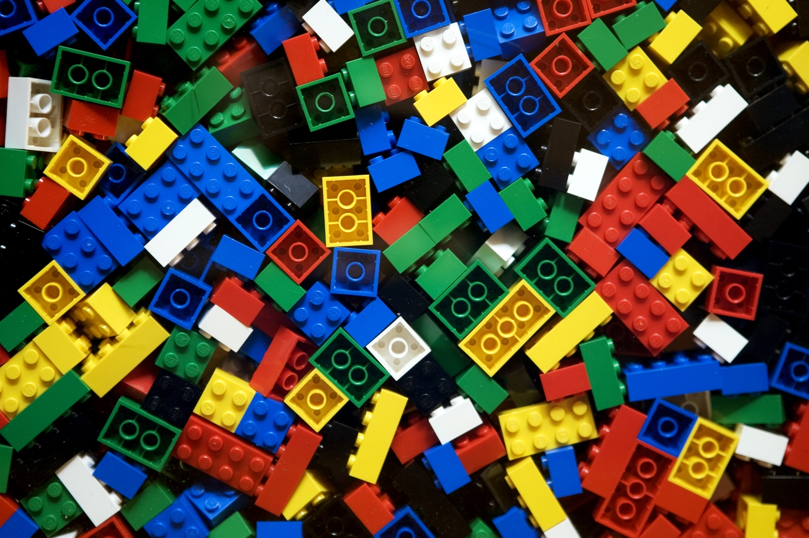
Notes:
If we build modules that we can assemble, they are much easier to distribute…
and these modules can all live on a single machine to start with..
However, going back to “hard” v. “unfamiliar”, if we never practice building modular systems, they will always seem unfamiliar and unsafe…
http://labstrip.com/wp-content/uploads/2012/07/Lego1.jpg

Slide 43
it’s about scale-free
composability
Notes:
which is a bummer, because scale-free composability is even more interesting than plain ol’ modular composability..

Slide 44
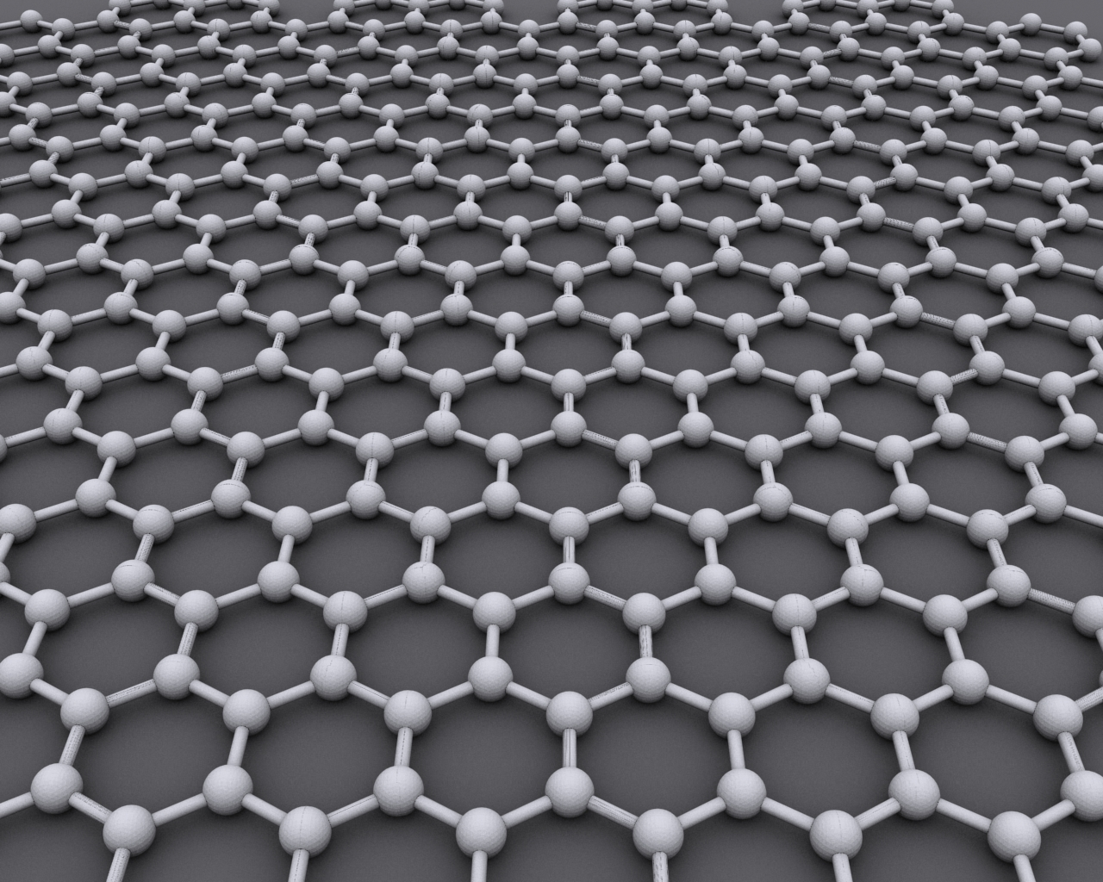
Notes:
when it comes to composability, we tend to stop here...
http://upload.wikimedia.org/wikipedia/commons/9/9e/Graphen.jpg

Slide 45
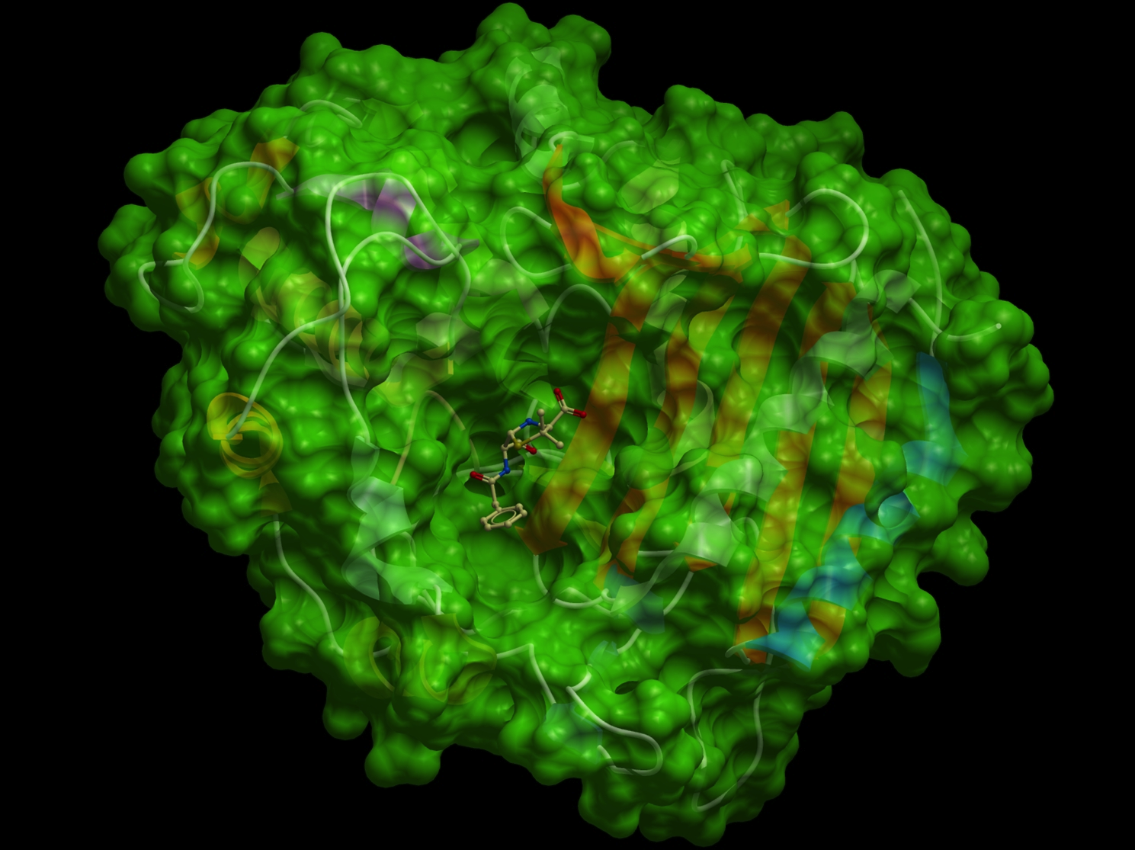
Notes:
but scale-free composability leads us to a different place...
http://www.molsoft.com/images/antibiotic_surface.jpg

Slide 46
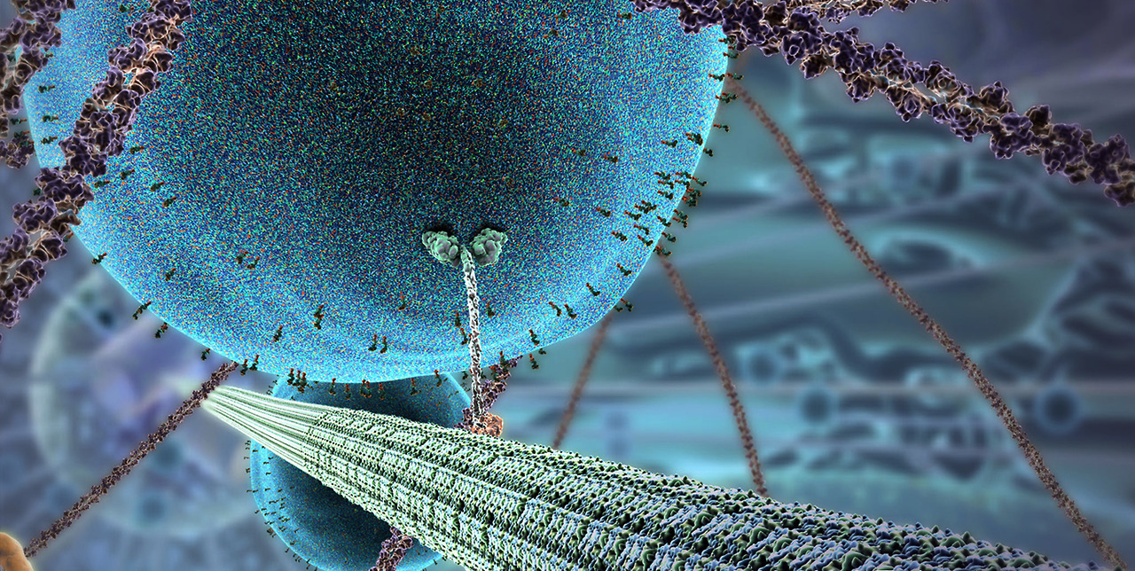
Notes:
http://31.media.tumblr.com/aa9e31b892c0c38876858f9662f1d938/tumblr_mia8seamuN1qbh26io3_1280.jpg

Slide 47
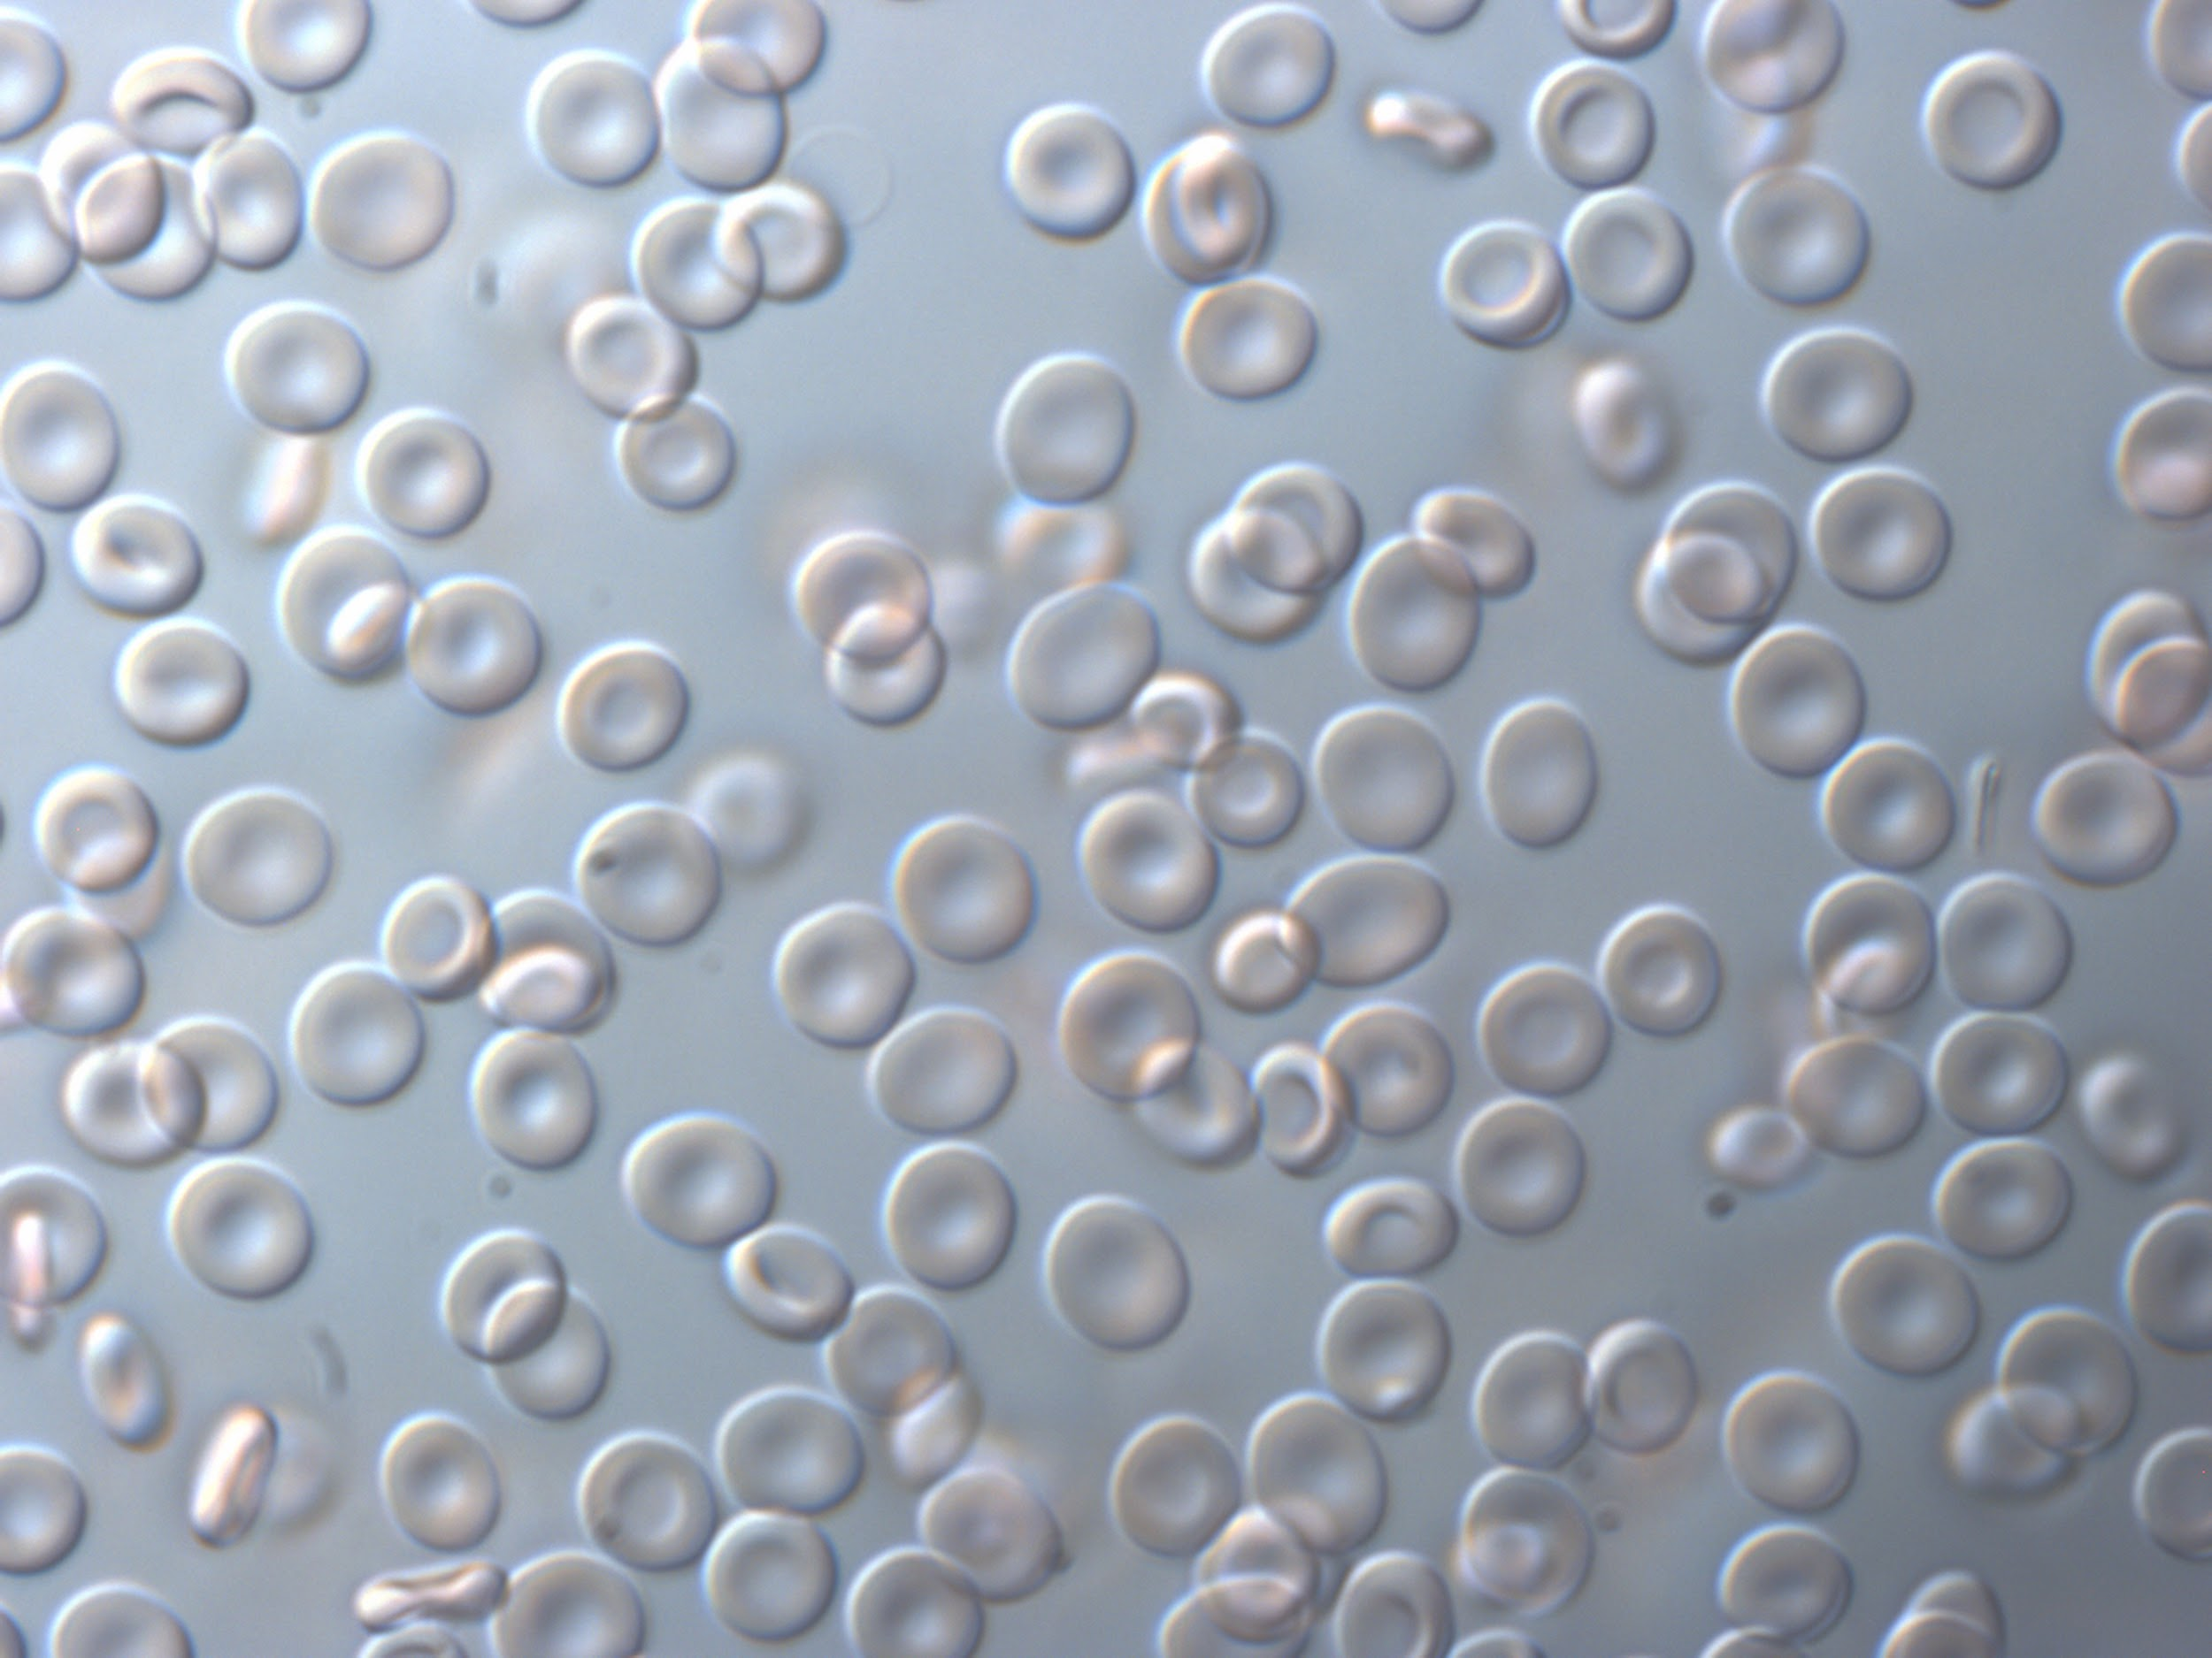
Notes:
http://www.nisenet.org/sites/default/files/red_blood_cells_nise.jpg

Slide 48
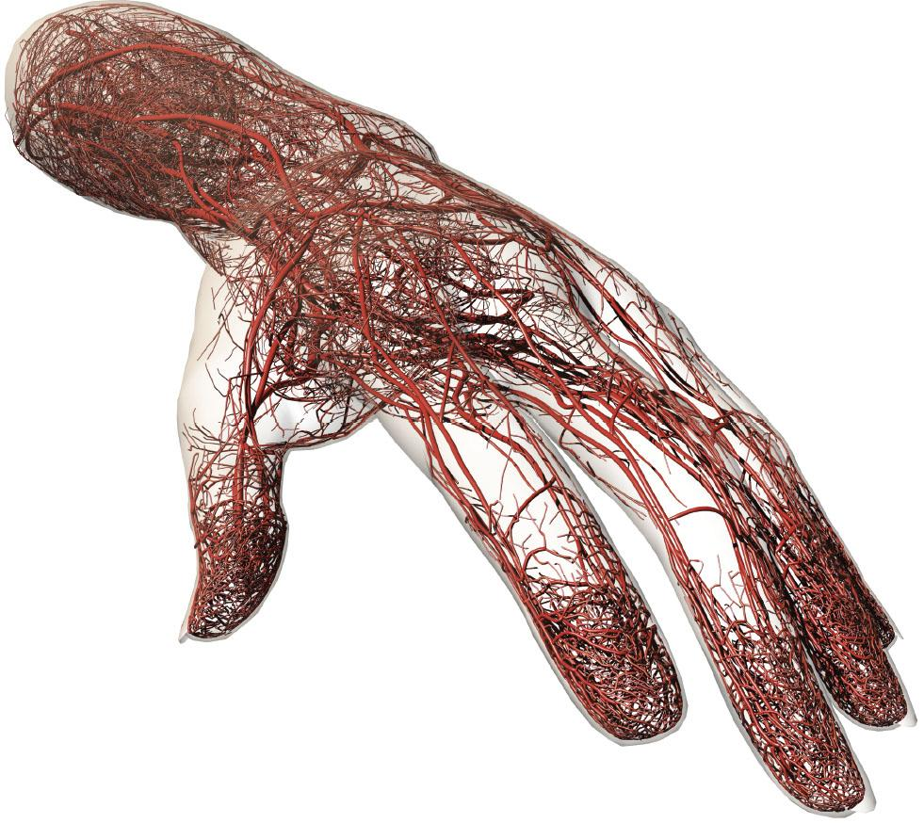
Notes:
http://www.joelertola.com/grfx/cap/cap_lg.jpg

Slide 49
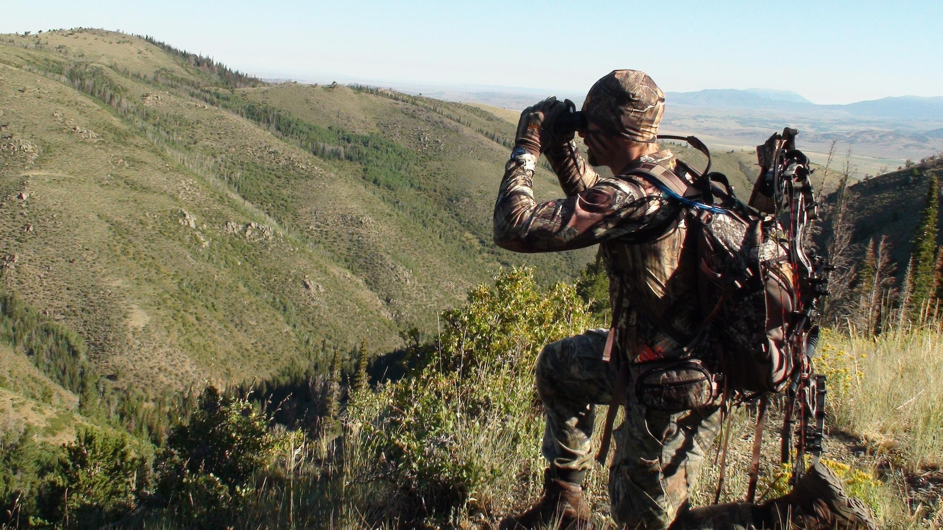
Notes:
http://blog.stickemarchery.com/wp-content/uploads/2011/08/DSC00926.jpg

Slide 50
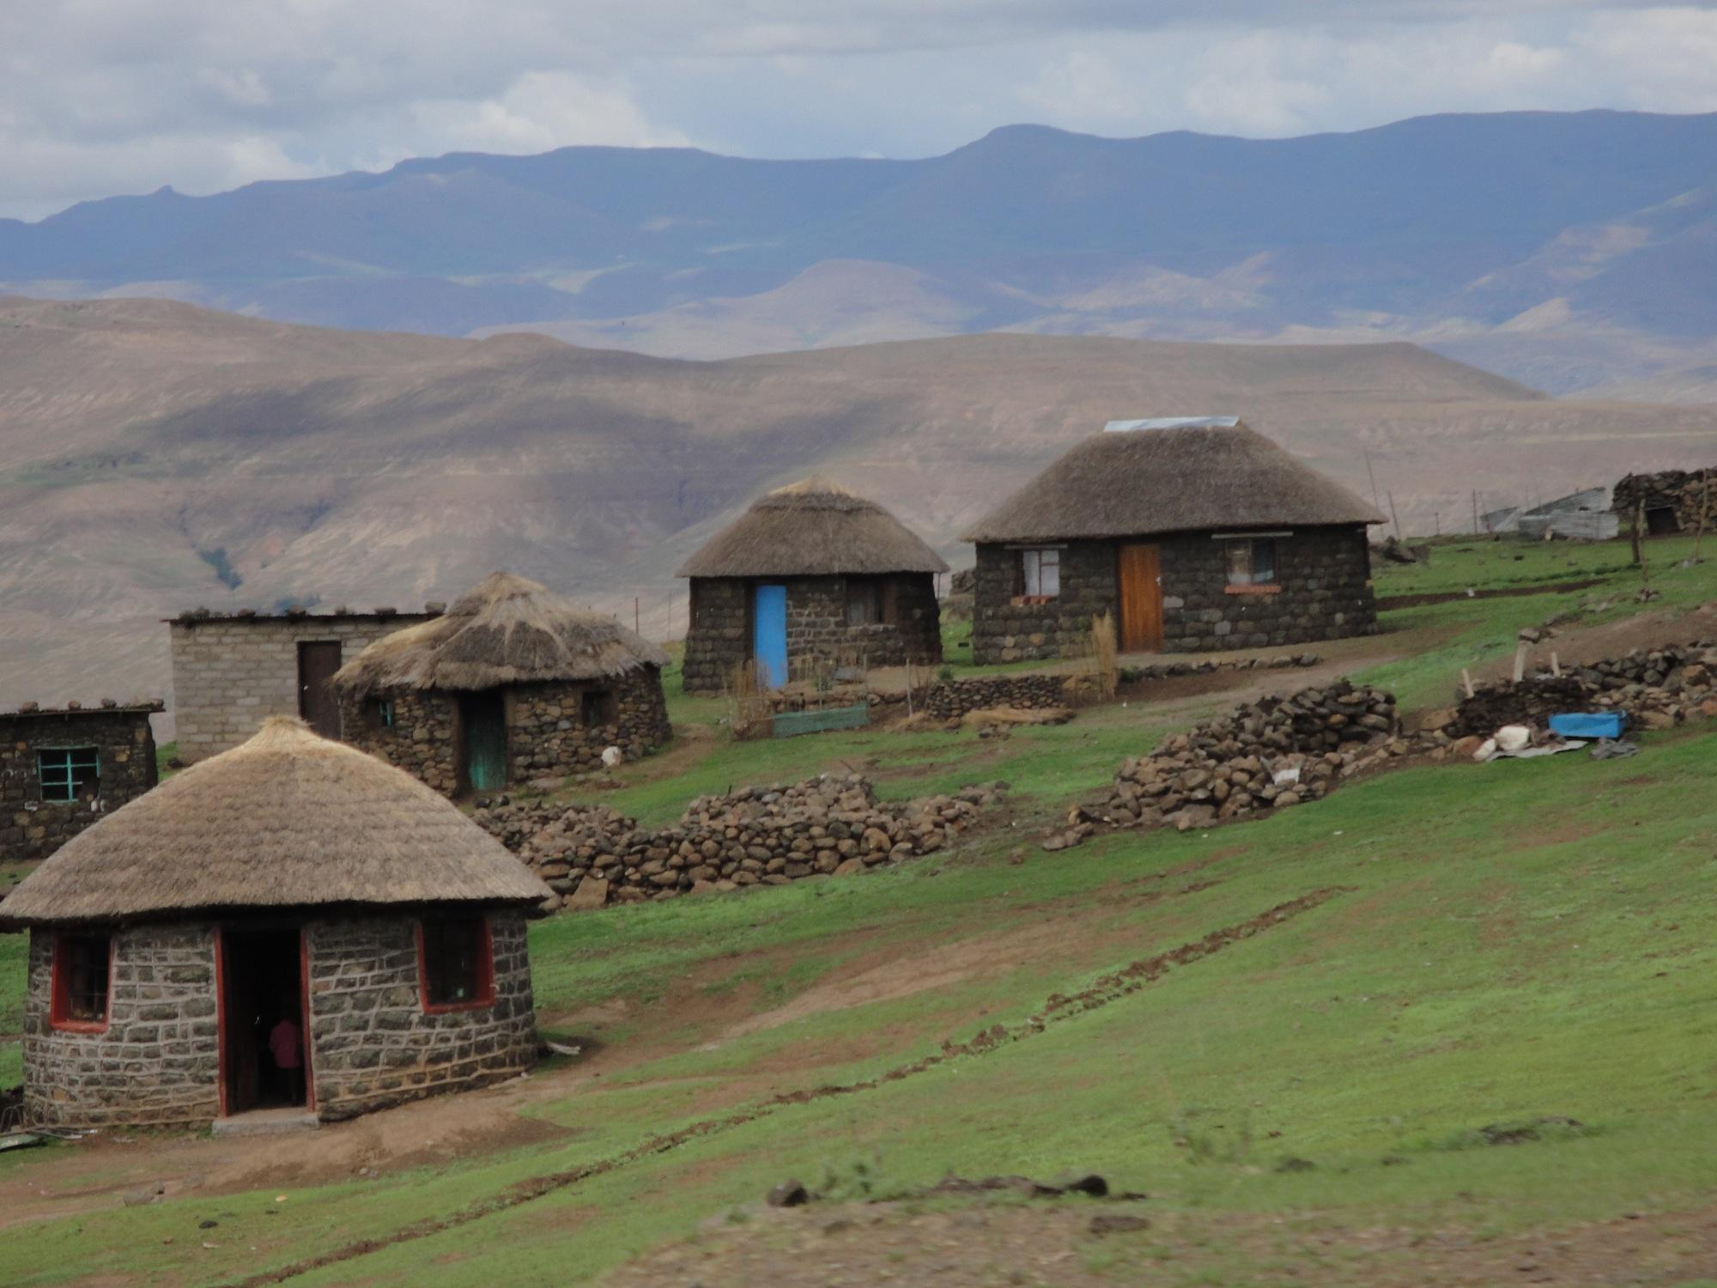
Notes:
http://upload.wikimedia.org/wikipedia/commons/9/98/Lesotho_mountain_village_(5285775857).jpg

Slide 51
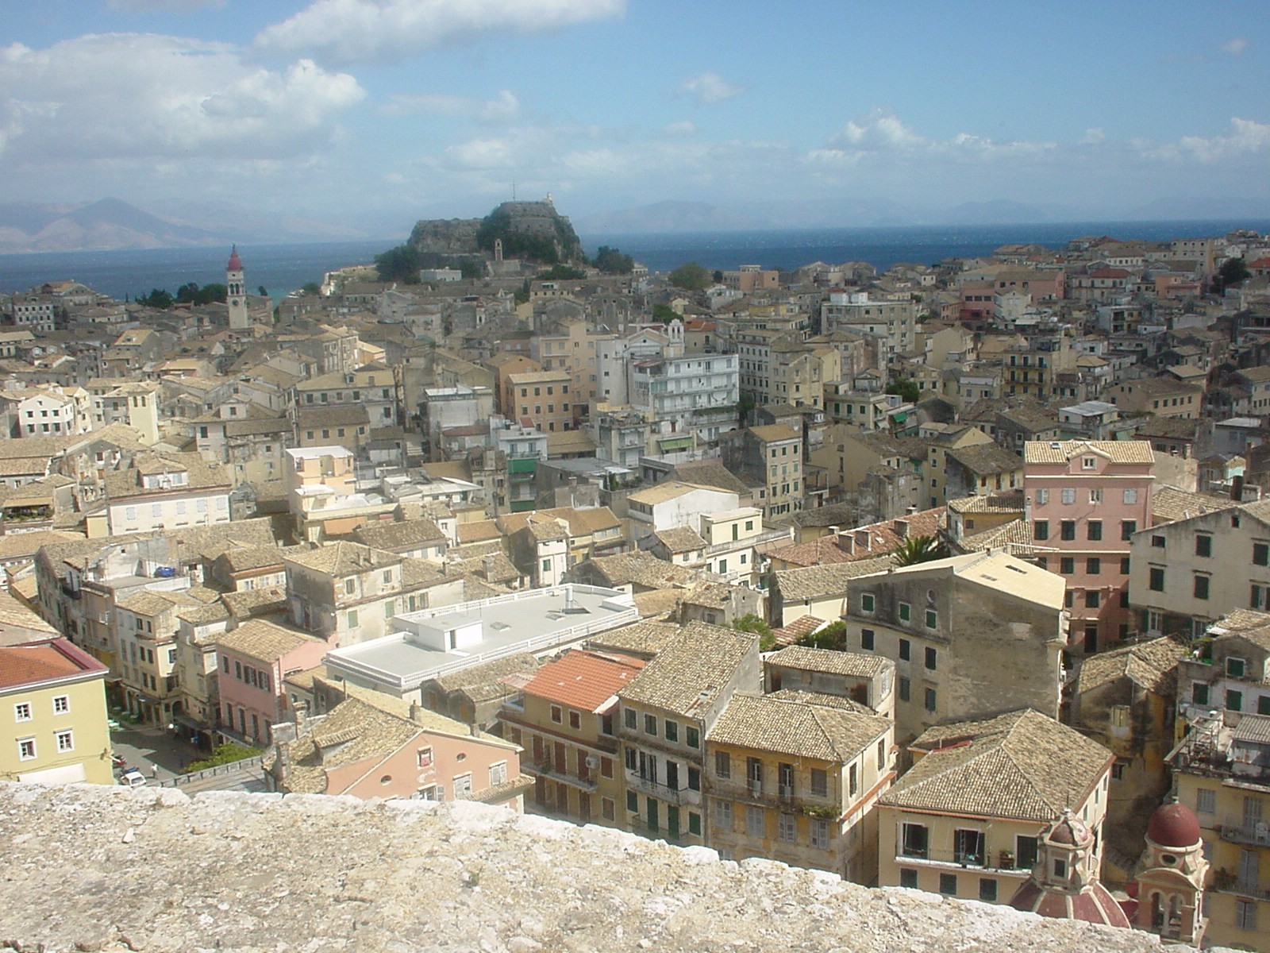
Notes:
http://upload.wikimedia.org/wikipedia/commons/4/42/Corfu_town.jpg

Slide 52

Notes:
http://learnenglish.com/blog/wp-content/uploads/2013/06/New-York-skyline_0.jpg

Slide 53
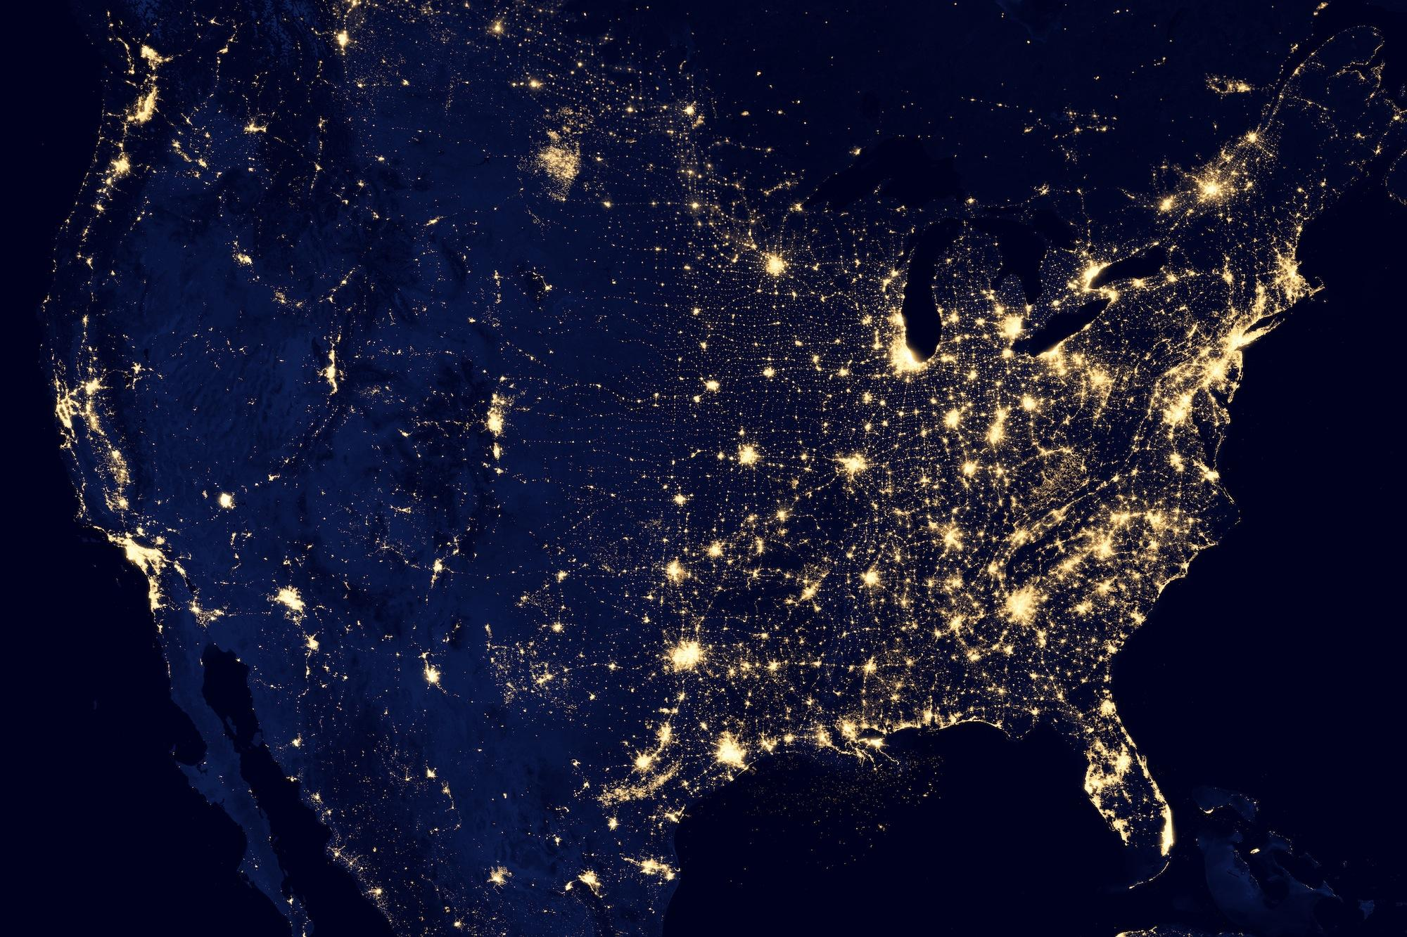
Notes:
http://eoimages.gsfc.nasa.gov/images/imagerecords/79000/79800/dnb_united_states_lrg.jpg

Slide 54
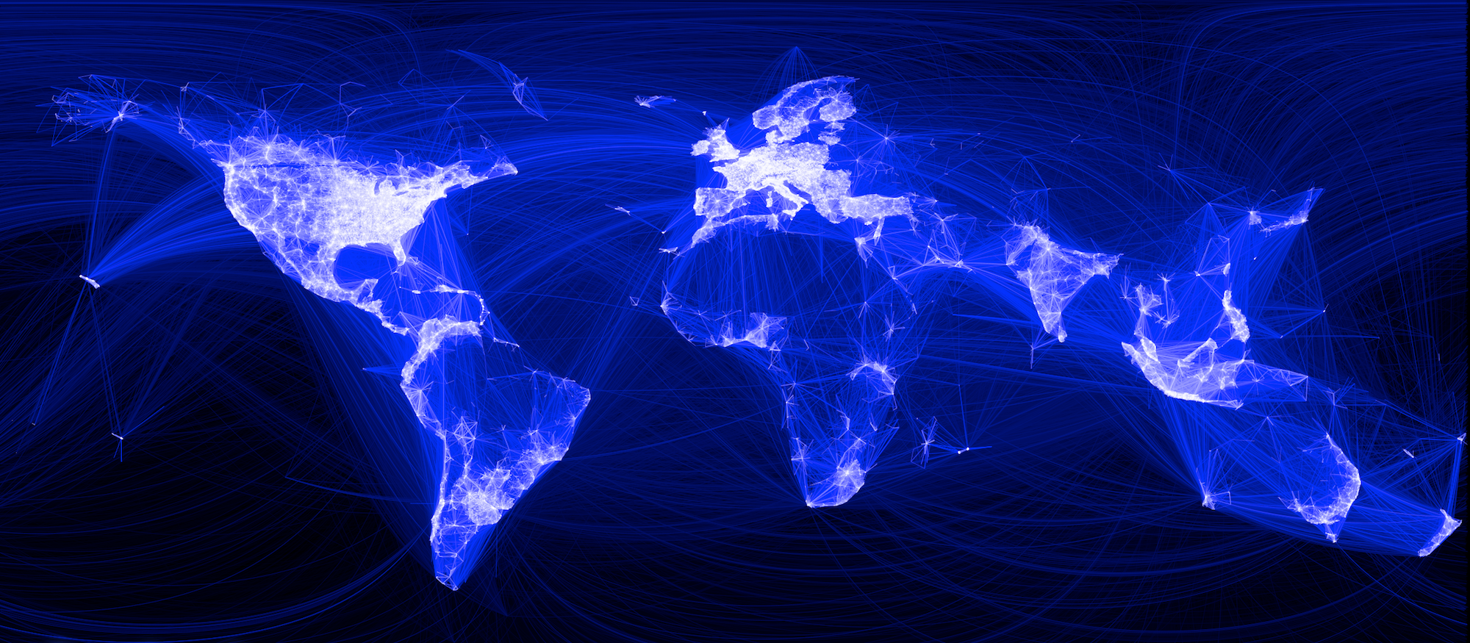
Notes:
http://gigaom2.files.wordpress.com/2010/12/163413_479288597199_9445547199_5658562_14158417_n.png

Slide 55

Notes:
sadly, we do end up with a single point of failure in the end…
but as you can see, we can fit a lot of interesting things at all sorts of scales on a single machine…
distributed system does not need to mean “costly”
http://d1jqu7g1y74ds1.cloudfront.net/wp-content/uploads/2009/09/bluemarble.jpg

Slide 56
*overwhelmed*
Notes:
You might be thinking by now that there is no way in hell my app is going to do all that….
and i’m not saying that you should...

Slide 57
effort ≠ impact
Notes:
but you will work just as hard on a distributed system as on a non-distributed system, we are all hard workers and we all love building amazing things..
and how we build our systems can significantly affect the impact those systems can have..

Slide 58
we can simplify
Notes:
we can simplify our effort

Slide 59
look for decentralized patterns
Notes:
we can look for decentralized patterns… and these occur at all scales..
we can use these in order to guarantee the invariants we want (instead of seeking fine grain control that results in untenable complexity)

Slide 60
a distributed toolkit approach
Notes:
I want to share these patterns with you and demonstrate that they are probably more “unfamiliar” than they are “hard”, and more importantly, I hope to demonstrate that these patterns are useful.

Slide 61
a distributed toolkit approach
discovery
pulling data
pushing data
failure detection
storing data
data reconciliation
load balancing
Notes:
for the rest of the talk, we’ll cover these in turn…
discovery, how to find things
pulling data
pushing data
failure detection
storing data, and how not to lose it
data reconciliation
and load balancing
and at the end i’ll describe a system built using these patterns
we will go through examples which are meant to make the unfamiliar familiar… there may be some details that are omitted or slightly altered, but the purpose is to demonstrate the general idea about each of these patterns so that you can not only think of using them, but also have some confidence and some intuition that they will work

Slide 62
discovery
Notes:
first, discovery

Slide 63
discovery
Notes:
a nice way to find things in a distributed fashion are Distributed Hash Tables...

Slide 64
discovery
Distributed Hash Tables (DHTs)

Slide 65
discovery - DHTs

Slide 66
discovery - DHTs
there are many implementations
Notes:
there are many implementations of these, but the one I am familiar with and describe here is called a Kademlia DHT...

Slide 67
discovery - DHTs
Kademlia DHT

Slide 68
discovery - DHTs
Kademlia DHT
(for discovery)
Notes:
Now, DHTs evolved to solve a different problem, mainly sharing and distributing files (I assume everyone here is familiar with BitTorrent)... I had only the use case of finding things, not getting data from them, so the discovery pattern described here does not implement a full Kademlia DHT, but only the parts needed to find things in a decentralized manner

Slide 69
discovery - DHTs
protocol + bucket storage
Notes:
There are two parts to implementing a DHT for the purpose of discovery, the protocol and bucket storage

Slide 70
discovery - DHTs - bucket storage
Notes:
let’s talk about bucket storage first

Slide 71
discovery - DHTs - bucket storage
node 00000000
1
0
k = 4
1
0
11010100
10101101
11010101
1
0
11001010
01000000
01100101
1
0
01001101
00100100
01001110
00110011
00100100
00010101
00000101
00100111
00010001
00000001
00010100
00001111
Notes:
a bucket is a way for every participant in the DHT, a node, to store information about other nodes.
what is interesting about the Kademlia bucket storage, also known as a k-bucket, is that it has two interesting properties
the first property is that it does not become too full
the second property is that it maintains more information on the nodes that are “close” to the local node, and less information on nodes considered far away
so, for example, here is a bucket storage for a node who’s id is all zeros
right away, notice that there are more nodes sharing the first zero bit there are nodes having 1 as the first bit
i will explain more as we work through an example

Slide 72
discovery - DHTs - bucket storage
00001010
node 00000000
1
0
k = 4
1
0
11010100
10101101
11010101
1
0
11001010
01000000
01100101
1
0
01001101
00100100
01001110
00110011
00100100
00010101
00000101
00100111
00010001
00000001
00010100
00001111
Notes:
let’s look at what happens if we try to store information about a node 0000,1010 in the bucket

Slide 73
discovery - DHTs - bucket storage
00001010
node 00000000
1
0
k = 4
1
0
11010100
10101101
11010101
1
0
11001010
01000000
01100101
1
0
01001101
00100100
01001110
00110011
00100100
00010101
00000101
00100111
00010001
00000001
00010100
00001111
Notes:
given a node id, we compare the first bit

Slide 74
discovery - DHTs - bucket storage
node 00000000
1
0
k = 4
00001010
1
0
11010100
10101101
11010101
1
0
11001010
01000000
01100101
1
0
01001101
00100100
01001110
00110011
00100100
00010101
00000101
00100111
00010001
00000001
00010100
00001111
Notes:
we then traverse the tree along the edge matching the bit we examined. we arrive at an inner node, so we need to compare the next bit

Slide 75
discovery - DHTs - bucket storage
node 00000000
1
0
k = 4
00001010
1
0
11010100
10101101
11010101
1
0
11001010
01000000
01100101
1
0
01001101
00100100
01001110
00110011
00100100
00010101
00000101
00100111
00010001
00000001
00010100
00001111
Notes:
the next bit is also 0, so traverse the tree along the 0 edge

Slide 76
discovery - DHTs - bucket storage
node 00000000
1
0
k = 4
1
0
11010100
00001010
10101101
11010101
1
0
11001010
01000000
01100101
1
0
01001101
00100100
01001110
00110011
00100100
00010101
00000101
00100111
00010001
00000001
00010100
00001111
Notes:
again, we find ourselves at an inner node, let’s compare the next bit

Slide 77
discovery - DHTs - bucket storage
node 00000000
1
0
k = 4
1
0
11010100
00001010
10101101
11010101
1
0
11001010
01000000
01100101
1
0
01001101
00100100
01001110
00110011
00100100
00010101
00000101
00100111
00010001
00000001
00010100
00001111
Notes:
also a zero, traverse the zero edge

Slide 78
discovery - DHTs - bucket storage
node 00000000
1
0
k = 4
1
0
11010100
10101101
11010101
1
0
11001010
01000000
00001010
01100101
1
0
01001101
00100100
01001110
00110011
00100100
00010101
00000101
00100111
00010001
00000001
00010100
00001111
Notes:
inner node again, compare bits

Slide 79
discovery - DHTs - bucket storage
node 00000000
1
0
k = 4
1
0
11010100
10101101
11010101
1
0
11001010
01000000
00001010
01100101
1
0
01001101
00100100
01001110
00110011
00100100
00010101
00000101
00100111
00010001
00000001
00010100
00001111
Notes:
traverse the zero edge
now, we arrive at a leaf node of the tree…
the k = 4 value shown is a limit on how many nodes we can store in a leaf of the tree
because the leaf has only 3 node ids in it, we can add the new node id to the bucket

Slide 80
discovery - DHTs - bucket storage
node 00000000
1
0
k = 4
1
0
11010100
10101101
11010101
1
0
11001010
01000000
01100101
1
0
01001101
00100100
01001110
00110011
00100100
00010101
00000101
00100111
00010001
00000001
00010100
00001111
00001010

Slide 81
discovery - DHTs - bucket storage
node 00000000
1
0
k = 4
1
0
11010100
10101101
11010101
1
0
11001010
01000000
01100101
1
0
01001101
00100100
01001110
00110011
00100100
00010101
00000101
00100111
00010001
00000001
00010100
00001111
00001010
Notes:
we have now successfully stored information about node with id 0000,1010..
in a real implementation, we store some satellite data as well, for example an IP address and a port number to which to connect to.. for the purposes of this example the node ids are representatives of data that will allow us to fulfill whatever purpose we have for the node

Slide 82
discovery - DHTs - bucket storage
00001100
node 00000000
1
0
k = 4
1
0
11010100
10101101
11010101
1
0
11001010
01000000
01100101
1
0
01001101
00100100
01001110
00110011
00100100
00010101
00000101
00100111
00010001
00000001
00010100
00001111
00001010
Notes:
let’s add another node

Slide 83
discovery - DHTs - bucket storage
00001100
node 00000000
1
0
k = 4
1
0
11010100
10101101
11010101
1
0
11001010
01000000
01100101
1
0
01001101
00100100
01001110
00110011
00100100
00010101
00000101
00100111
00010001
00000001
00010100
00001111
00001010
Notes:
as before, we will walk the tree and compare successive bits in order to find the place for the node id to be stored in

Slide 84
discovery - DHTs - bucket storage
node 00000000
1
0
k = 4
00001100
1
0
11010100
10101101
11010101
1
0
11001010
01000000
01100101
1
0
01001101
00100100
01001110
00110011
00100100
00010101
00000101
00100111
00010001
00000001
00010100
00001111
00001010

Slide 85
discovery - DHTs - bucket storage
node 00000000
1
0
k = 4
00001100
1
0
11010100
10101101
11010101
1
0
11001010
01000000
01100101
1
0
01001101
00100100
01001110
00110011
00100100
00010101
00000101
00100111
00010001
00000001
00010100
00001111
00001010

Slide 86
discovery - DHTs - bucket storage
node 00000000
1
0
k = 4
1
0
11010100
10101101
00001100
11010101
1
0
11001010
01000000
01100101
1
0
01001101
00100100
01001110
00110011
00100100
00010101
00000101
00100111
00010001
00000001
00010100
00001111
00001010

Slide 87
discovery - DHTs - bucket storage
node 00000000
1
0
k = 4
1
0
11010100
10101101
00001100
11010101
1
0
11001010
01000000
01100101
1
0
01001101
00100100
01001110
00110011
00100100
00010101
00000101
00100111
00010001
00000001
00010100
00001111
00001010

Slide 88
discovery - DHTs - bucket storage
node 00000000
1
0
k = 4
1
0
11010100
10101101
11010101
1
0
11001010
01000000
00001100
01100101
1
0
01001101
00100100
01001110
00110011
00100100
00010101
00000101
00100111
00010001
00000001
00010100
00001111
00001010

Slide 89
discovery - DHTs - bucket storage
node 00000000
1
0
k = 4
1
0
11010100
10101101
11010101
1
0
11001010
01000000
00001100
01100101
1
0
01001101
00100100
01001110
00110011
00100100
00010101
00000101
00100111
00010001
00000001
00010100
00001111
00001010

Slide 90
discovery - DHTs - bucket storage
node 00000000
1
0
k = 4
1
0
11010100
10101101
11010101
1
0
11001010
01000000
00001100
01100101
1
0
01001101
00100100
01001110
00110011
00100100
00010101
00000101
00100111
00010001
00000001
00010100
00001111
FULL
00001010
Notes:
so we ended up at the same bucket as last time
notice however, that now, that bucket has 4 nodes, and our k = 4, meaning the bucket is full…
because we are on the “near” side to the local node, that is, the prefix of our local node with all zeros is shared with this bucket, we are allowed to split it

Slide 91
discovery - DHTs - bucket storage
node 00000000
1
0
k = 4
1
0
11010100
10101101
11010101
1
0
11001010
01000000
00001100
01100101
1
0
01001101
SPLIT
00100100
01001110
00110011
00100100
00010101
00000101
00100111
00010001
00000001
00010100
00001111
00001010

Slide 92
discovery - DHTs - bucket storage
node 00000000
1
0
k = 4
1
0
11010100
10101101
11010101
1
0
11001010
01000000
00001100
01100101
1
0
01001101
00100100
01001110
00110011
0
00100100
1
00010101
00100111
00010001
00010100
00000101
00000001
00001111
00001010
Notes:
since we split the bucket we now have to redistribute the nodes that were stored in it
we do this as expected, using the relevant bit for comparison

Slide 93
discovery - DHTs - bucket storage
node 00000000
1
0
k = 4
1
0
11010100
10101101
11010101
1
0
11001010
01000000
00001100
01100101
1
0
01001101
00100100
01001110
00110011
0
00100100
1
00010101
00100111
00010001
00010100
00001111
00000101
00001010
00000001
Notes:
with the bucket now split, we compare the next bit in the node id we are inserting

Slide 94
discovery - DHTs - bucket storage
node 00000000
1
0
k = 4
1
0
11010100
10101101
11010101
1
0
11001010
01000000
00001100
01100101
1
0
01001101
00100100
01001110
00110011
0
00100100
1
00010101
00100111
00010001
00010100
00001111
00000101
00001010
00000001
Notes:
notice that now the selected bucket has only 2 nodes in it, so we can safely place the node in the bucket

Slide 95
discovery - DHTs - bucket storage
node 00000000
1
0
k = 4
1
0
11010100
10101101
11010101
1
0
11001010
01000000
01100101
1
0
01001101
00100100
01001110
00110011
0
00100100
1
00010101
00100111
00010001
00010100
00001111
00000101
00001010
00000001
00001100

Slide 96
discovery - DHTs - bucket storage
node 00000000
1
0
k = 4
1
0
11010100
10101101
11010101
1
0
11001010
01000000
01100101
1
0
01001101
00100100
01001110
00110011
0
00100100
1
00010101
00100111
00010001
00010100
00001111
00000101
00001010
00000001
00001100
Notes:
what you just saw was how the kademlia bucket maintains information about nodes that are close to the local node (i.e. have similar prefix)

Slide 97
discovery - DHTs - bucket storage
11001110
node 00000000
1
0
k = 4
1
0
11010100
10101101
11010101
1
0
11001010
01000000
01100101
1
0
01001101
00100100
01001110
00110011
0
00100100
1
00010101
00100111
00010001
00010100
00001111
00000101
00001010
00000001
00001100
Notes:
next, lets take a look at what happens to “far away” nodes

Slide 98
discovery - DHTs - bucket storage
11001110
node 00000000
1
0
k = 4
1
0
11010100
10101101
11010101
1
0
11001010
01000000
01100101
1
0
01001101
00100100
01001110
00110011
0
00100100
1
00010101
00100111
00010001
00010100
00001111
00000101
00001010
00000001
00001100
Notes:
as before, we start comparing the bits

Slide 99
discovery - DHTs - bucket storage
11001110
node 00000000
1
0
k = 4
1
0
11010100
10101101
11010101
1
0
11001010
01000000
01100101
1
0
01001101
00100100
01001110
00110011
0
FULL
00100100
1
00010101
00100111
00010001
00010100
00001111
00000101
00001010
00000001
00001100
Notes:
again, the bucket is full.. however, because we are not “near” the local node, we are not allowed to split the bucket

Slide 100
discovery - DHTs - bucket storage
11001110
node 00000000
1
0
k = 4
1
0
11010100
10101101
11010101
1
0
11001010
01000000
01100101
1
0
DON’T SPLIT
01001101
00100100
01001110
00110011
0
00100100
1
00010101
00100111
00010001
00010100
00001111
00000101
00001010
00000001
00001100

Slide 101
discovery - DHTs - bucket storage
11001110
node 00000000
1
0
k = 4
1
0
11010100
10101101
11010101
1
0
11001010
01000000
01100101
1
0
PING NODES
01001101
00100100
01001110
00110011
0
00100100
1
00010101
00100111
00010001
00010100
00001111
00000101
00001010
00000001
00001100
Notes:
instead, what we will do is PING a select number of nodes in the bucket to determine if they are still alive

Slide 102
discovery - DHTs - bucket storage
11001110
node 00000000
1
0
k = 4
1
0
11010100
10101101
11010101
1
0
11001010
01000000
01100101
1
0
REPLACE
NON-RESPONSIVE
NODE
01001101
00100100
01001110
00110011
0
00100100
1
00010101
00100111
00010001
00010100
00001111
00000101
00001010
00000001
00001100
Notes:
let’s say that node 1010,1101 did not respond..
thus, we can replace it in the bucket

Slide 103
discovery - DHTs - bucket storage
node 00000000
1
0
k = 4
1
0
11010100
11001110
11010101
1
0
11001010
01000000
01100101
1
0
REPLACE
NON-RESPONSIVE
NODE
01001101
00100100
01001110
00110011
0
00100100
1
00010101
00100111
00010001
00010100
00001111
00000101
00001010
00000001
00001100

Slide 104
discovery - DHTs - bucket storage
node 00000000
1
0
k = 4
1
0
11010100
11001110
11010101
1
0
11001010
01000000
01100101
1
0
01001101
00100100
01001110
00110011
0
00100100
1
00010101
00100111
00010001
00010100
00001111
00000101
00001010
00000001
00001100

Slide 105
discovery - DHTs - bucket storage
node 00000000
1
0
k = 4
1
0
11010100
11001110
11010101
1
0
11001010
01000000
01100101
1
0
01001101
00100100
01001110
00110011
0
00100100
1
00010101
00100111
00010001
00010100
00001111
00000101
00001010
00000001
00001100
Notes:
once again, the new node is stored, but instead of adding to the size of our bucket, we replaced an inactive node…
if all nodes in the bucket would respond successfully, then the new node would be discarded and not stored here
this is ok, because some other node that was nearer to it will make room in it’s bucket as we shown with the first example…
this is the general mechanism that give us the two interesting properties of k-bucket storage:
- the bucket never becomes too full
- the bucket maintains more information about “near by” nodes than it does about far away ones

Slide 106
discovery - DHTs - bucket storage
“typical” config:
k = 20
Notes:
in a typical implementation, k equals 20

Slide 107
discovery - DHTs - bucket storage
each node stores info on 20 * lg (n) nodes
Notes:
with this type of implementation,
this ends up with each node storing information on around 20 * lg(n) other nodes

Slide 108
discovery - DHTs - bucket storage
“lg”s are awesome:
20 * lg(1,000,000,000) = ~ 598
20 * lg(1,000,000,000,000) = ~ 798
20 * lg(1,000,000,000,000,000) = ~ 997
Notes:
and “lg”s are our friend, because in a network with Quadrillion nodes, each node would only need to store information on around 1,000 other nodes for the entire distributed system to maintain information on where things are

Slide 109
discovery - DHTs - protocol
Notes:
so that’s bucket storage works, the other part of the DHT equation is the protocol for communication..

Slide 110
discovery - DHTs - protocol
FIND_NODE and PING
Notes:
as I mentioned before, the discovery use case for a DHT is a stripped down version, so we only use FIND_NODE and PING remote procedure calls..
we already what PING is used for when we checked on whether or nodes are still responsive..
now, let’s look at how FIND_NODE works

Slide 111
discovery - DHTs - protocol
S-0
S-1
S-2
Notes:
for this example, we have a DHT with 3 seed nodes

Slide 112
discovery - DHTs - protocol
S-0
N
S-1
S-2
Notes:
a new node comes online and it’s given the information about the 3 seed nodes

Slide 113
discovery - DHTs - protocol
S-0
N
S-1
S-2
Notes:
it will then try to look for itself...

Slide 114
discovery - DHTs - protocol
S-0
FIND_NODE (N)
N
S-1
S-2
Notes:
by sending a FIND_NODE(N) (and giving itself as the parameter) to a seed node

Slide 115
discovery - DHTs - protocol
(stores N)
S-0
N
S-1
S-2
Notes:
the seed node will store the data for the new node on the network (it found out about it because it just received communication from it)

Slide 116
discovery - DHTs - protocol
S-0
(returns closest)
N
S-1
S-2
Notes:
then it will search through its bucket storage and retrieve a list of nodes closest to the id of the new N node…

Slide 117
discovery - DHTs - protocol
S-0
FIND_NODE (N)
N
S-1
S-2
Notes:
the new node repeats the process with other seeds

Slide 118
discovery - DHTs - protocol
S-0
N
(stores N)
S-1
S-2

Slide 119
discovery - DHTs - protocol
S-0
(returns closest)
N
S-1
S-2

Slide 120
discovery - DHTs - protocol
S-0
N
S-1
FIND_NODE (N)
S-2

Slide 121
discovery - DHTs - protocol
S-0
N
S-1
S-2
(stores N)

Slide 122
discovery - DHTs - protocol
S-0
N
S-1
(returns closest)
S-2

Slide 123
discovery - DHTs - protocol
S-0
N
S-1
S-2
Notes:
now, since every seed is different, they will return different nodes that are closest to the new N node…
this is how the new N node becomes aware of other peers

Slide 124
discovery - DHTs - protocol
N-73
S-0
N-33
N
S-1
N-11
N-9
S-2
Notes:
at this point, the new node will continue to search for itself with the new nodes it discovered

Slide 125
discovery - DHTs - protocol
N-73
FIND_NODE (N)
S-0
N-33
N
S-1
N-11
N-9
S-2

Slide 126
discovery - DHTs - protocol
(stores N)
N-73
S-0
N-33
N
S-1
N-11
N-9
S-2
Notes:
as the seeds before, node N-73 will store the information of the node that just contacted it,

Slide 127
discovery - DHTs - protocol
N-73
(returns closest)
S-0
N-33
N
S-1
N-11
N-9
S-2
Notes:
and return even closer nodes that it knows about
this happens, because if you remember from the bucket storage section, nodes store most information about nodes closest to them, since N-73 in this example is closer to N than S-0 was… it will have more room in it’s bucket storage for more nodes, so it might know about some that S-0 did not know about...

Slide 128
discovery - DHTs - protocol
N-73
S-0
N-33
N
S-1
N-11
N-9
S-2

Slide 129
discovery - DHTs - protocol
N-73
S-0
N-33
N
S-1
N-11
N-9
S-2
Notes:
N goes through the process with the other nodes it finds...

Slide 130
discovery - DHTs - protocol
N-73
S-0
N-33
N
S-1
N-11
N-9
S-2
Notes:
and gets a list of nodes even closer to it

Slide 131
discovery - DHTs - protocol
N-44
N-73
N-27
S-0
N-96
N-33
N
S-1
N-11
N-9
S-2
N-3
Notes:
the process repeats

Slide 132
discovery - DHTs - protocol
N-44
N-73
N-27
S-0
N-96
N-33
N
S-1
N-11
N-9
S-2
N-3

Slide 133
discovery - DHTs - protocol
N-44
N-73
N-27
S-0
N-96
N-33
N
S-1
N-11
N-9
S-2
N-3
Notes:
we find more nodes

Slide 134
discovery - DHTs - protocol
N-44
N-73
N-27
S-0
N-96
N-33
N
S-1
N-6
N-11
N-9
S-2
N-3
Notes:
repeat

Slide 135
discovery - DHTs - protocol
N-44
N-73
N-27
S-0
N-96
N-33
N
S-1
N-6
N-11
N-9
S-2
N-3

Slide 136
discovery - DHTs - protocol
N-44
N-73
N-27
S-0
N-96
N-33
N
S-1
N-6
N-11
N-9
S-2
N-3
Notes:
until we reach a point where the new node N no longer finds any nodes closest to it
at the conclusion of this seeding process.. all the nodes that N contacted know of N’s existence (if they have room for it)
and N knows of the nodes in its local neighborhood...

Slide 137
discovery - DHTs - protocol
we can now find things
Notes:
with discovery and DHTs we can now find things...

Slide 138
pulling data
Notes:
let’s now talk about how to pull data from others…

Slide 139
pulling data

Slide 140
pulling data
DHTs
Notes:
again, DHTs to the rescue

Slide 141
pulling data - DHTs

Slide 142
pulling data - DHTs
N-44
N-73
N-27
S-0
N-96
N-33
N
S-1
N-6
N-11
N-9
S-2
N-3
Notes:
as before, we have a node N that knows about it’s peers… but now, let’s turn this into a real DHT.

Slide 143
pulling data - DHTs
7fb9...
7548...
3771...
a929...
b0a9...
accc...
1eff...
b77a...
8baf...
a31c...
923b...
64ef...
ce34...
fa40...
0e8b...
beeb...
20af...
3547...
ce04...
0d05...
04db...
20ac...
339e...
5d8e...
N
c947...
15a9...
d688...
4d9f...
d94a...
e475...
ccdf...
9d41...
3b7c...
cd55...
9f46...
f911...
5335...
2d68...
9ac4...
2c76...
65a6...
d912...
a76f...
e82d...
09bf...
abf2...
8d38...
cf01...
Notes:
where we have actual data being stored on nodes..

Slide 144
pulling data - DHTs - add BitTorrent
7fb9...
7548...
3771...
a929...
b0a9...
accc...
1eff...
b77a...
8baf...
a31c...
923b...
64ef...
ce34...
fa40...
0e8b...
beeb...
20af...
3547...
ce04...
0d05...
04db...
20ac...
339e...
5d8e...
N
c947...
15a9...
d688...
4d9f...
d94a...
e475...
ccdf...
9d41...
3b7c...
cd55...
9f46...
f911...
5335...
2d68...
9ac4...
2c76...
65a6...
d912...
a76f...
e82d...
09bf...
abf2...
8d38...
cf01...
Notes:
implementing the rest of the BitTorrent protocol, we now have an effective way of pulling data… BitTorrent is used all over the place nowadays so this is as far as we’ll go in this example...

Slide 145
pulling data
direct connections
Notes:
now, distributed data is great, but sometimes we just want the big pipe to stream us all the data we can get
nothing new here, but just as a reminder, we can create direct connections

Slide 146
pulling data - direct connections

Slide 147
pulling data - direct connections
N-44
N-73
N-27
S-0
N-96
N-33
N
S-1
N-6
N-11
N-9
S-2
N-3
Notes:
as before, if we know how to find other nodes...

Slide 148
pulling data - direct connections
N-44
N-73
N-27
S-0
N-96
N-33
N
S-1
N-6
N-11
N-9
S-2
N-3
Notes:
...then we can connect directly to that node…. the Internet can do the hard part there..

Slide 149
pulling data - direct connections
use merkle-trees
to get only what you need
(more later)
Notes:
additional caveat that we’ll cover later, we can make this transfer more efficient by sending only the parts of the data we don’t have.. but more on that later..

Slide 150
pulling data - direct connections
we can now retrieve data
Notes:
so, we can now retrieve data

Slide 151
pushing data
Notes:
let’s talk about actively pushing data...

Slide 152
pushing data

Slide 153
pushing data
gossip
Notes:
one way to do it is through a family of protocols known as “gossip”

Slide 154
pushing data - gossip

Slide 155
pushing data - gossip
every connected node is
informed of the state
of every other connected node
Notes:
much like in human gossip, the purpose is to inform every other member of a piece of information..

Slide 156
pushing data - gossip
scuttlebutt reconciliation
Notes:
the particular strategy for sharing information that will be described here is based on “scuttlebutt reconciliation”

Slide 157
pushing data - gossip
scuttlebutt reconciliation
(there are others)
Notes:
there are others, and the invariants that they offer are somewhat different depending on which strategy is chosen...

Slide 158
pushing data - gossip
Notes:
ok, let’s set up a cluster for gossipping...

Slide 159
pushing data - gossip
G-0
Notes:
we start with a node, let’s call it G-0

Slide 160
pushing data - gossip
G-0
S-2
S-0
S-1
Notes:
G-0, when it starts, will be notified of seeds that are part of the cluster, in this case S-0, S-1, and S-2…
for the purposes of this example, our cluster will only have 4 nodes as illustrated here, but it will be enough...

Slide 161
pushing data - gossip
G-0
S-2
vc = 22
S-0
vc = 17
S-1
vc = 27
Notes:
each gossip node has an internal vector clock.. it is not related to actual time, but it is incremented every time data is changed… will show what that means later on..
for now, these are the values of the vector clocks for each of the seed nodes..

Slide 162
pushing data - gossip
G-0
S-2
vc = 22
S-0
vc = 17
S-1
vc = 27
S-0@17 : foo = [“A”,17]
S-1@27 : foo = [“B”,27]
S-2@22 : foo = [“K”,22]
S-0@17 : foo = [“A”,17]
S-1@27 : foo = [“B”,27]
S-2@22 : foo = [“K”,22]
S-0@17 : foo = [“A”,17]
S-1@27 : foo = [“B”,27]
S-2@22 : foo = [“K”,22]
Notes:
additionally, each node maintains its awareness of every other node…
for example.. depicted here, we can see that S-0 knows that it is at vector clock value of 17.. and it has a property foo with value “A” that happened at vector clock value 17
similarly, it is aware of node S-1 at vector clock 27.. and it knows that S-1 has a property foo with value “B” at vector clock value 27
it is also aware of node S-2 at vector clock 22.. and it knows that S-2 has a property foo with value “K” at vector clock value 22
other nodes maintain similar awareness..
at the start of this example.. the cluster is in a steady state and everyone sees the latest information..

Slide 163
pushing data - gossip
G-0
vc = 0
S-2
vc = 22
S-0
vc = 17
S-1
vc = 27
S-0@17 : foo = [“A”,17]
S-1@27 : foo = [“B”,27]
S-2@22 : foo = [“K”,22]
S-0@17 : foo = [“A”,17]
S-1@27 : foo = [“B”,27]
S-2@22 : foo = [“K”,22]
S-0@17 : foo = [“A”,17]
S-1@27 : foo = [“B”,27]
S-2@22 : foo = [“K”,22]
Notes:
when a new node joins a gossip cluster, it starts with a vector clock with the value of 0

Slide 164
pushing data - gossip
G-0
vc = 0
S-2
vc = 22
S-0@0 :
S-1@0 :
S-2@0 :
S-0
vc = 17
S-1
vc = 27
S-0@17 : foo = [“A”,17]
S-1@27 : foo = [“B”,27]
S-2@22 : foo = [“K”,22]
S-0@17 : foo = [“A”,17]
S-1@27 : foo = [“B”,27]
S-2@22 : foo = [“K”,22]
S-0@17 : foo = [“A”,17]
S-1@27 : foo = [“B”,27]
S-2@22 : foo = [“K”,22]
Notes:
additionally, since it has never seen any other node, it’s local awareness consists of the nodes it knows about: S-0, S-1, and S-2 all the vector clock of 0 (because it hasn’t received any other information)

Slide 165
pushing data - gossip
G-0
vc = 0
S-2
vc = 22
S-0@0 :
S-1@0 :
S-2@0 :
S-0
vc = 17
S-1
vc = 27
S-0@17 : foo = [“A”,17]
S-1@27 : foo = [“B”,27]
S-2@22 : foo = [“K”,22]
S-0@17 : foo = [“A”,17]
S-1@27 : foo = [“B”,27]
S-2@22 : foo = [“K”,22]
S-0@17 : foo = [“A”,17]
S-1@27 : foo = [“B”,27]
S-2@22 : foo = [“K”,22]
Notes:
even though the node G-0 has no information on other nodes, it knows they exist..
it randomly selects a peer to contact..

Slide 166
pushing data - gossip
G-0@0 S-0@0
S-1@0 S-2@0
G-0
vc = 0
S-2
vc = 22
S-0@0 :
S-1@0 :
S-2@0 :
S-0
vc = 17
S-1
vc = 27
S-0@17 : foo = [“A”,17]
S-1@27 : foo = [“B”,27]
S-2@22 : foo = [“K”,22]
S-0@17 : foo = [“A”,17]
S-1@27 : foo = [“B”,27]
S-2@22 : foo = [“K”,22]
S-0@17 : foo = [“A”,17]
S-1@27 : foo = [“B”,27]
S-2@22 : foo = [“K”,22]
Notes:
it will send what is known as a “digest”.. that is, G-0 will share with S-1 what G-0 knows about the state of the cluster..
in this case… it knows only that G-0, S-0, S-1, and S-2 exists and the last seen vector clock for those is 0.

Slide 167
pushing data - gossip
G-0@0 S-0@0
S-1@0 S-2@0
G-0
vc = 0
S-2
vc = 22
S-0@0 :
S-1@0 :
S-2@0 :
S-0
vc = 17
S-1
vc = 27
S-0@17 : foo = [“A”,17]
S-1@27 : foo = [“B”,27]
S-2@22 : foo = [“K”,22]
S-0@17 : foo = [“A”,17]
S-1@27 : foo = [“B”,27]
S-2@22 : foo = [“K”,22]
S-0@17 : foo = [“A”,17]
S-1@27 : foo = [“B”,27]
S-2@22 : foo = [“K”,22]
Notes:
S-1 will examine the digest…
it sees G-0@0

Slide 168
pushing data - gossip
G-0@0 S-0@0
S-1@0 S-2@0
G-0
vc = 0
S-2
vc = 22
S-0@0 :
S-1@0 :
S-2@0 :
S-0
vc = 17
S-1
vc = 27
S-0@17 : foo = [“A”,17]
S-1@27 : foo = [“B”,27]
S-2@22 : foo = [“K”,22]
S-0@17 : foo = [“A”,17]
S-1@27 : foo = [“B”,27]
S-2@22 : foo = [“K”,22]
G-0@0 :
S-0@17 : foo = [“A”,17]
S-1@27 : foo = [“B”,27]
S-2@22 : foo = [“K”,22]
Notes:
because it did not know of G-0s existence, it adds it to it’s local awareness… and notes that version 0 is the last version seen..

Slide 169
pushing data - gossip
G-0@0 S-0@0
S-1@0 S-2@0
G-0
vc = 0
S-2
vc = 22
S-0@0 :
S-1@0 :
S-2@0 :
S-0
vc = 17
S-1
vc = 27
S-0@17 : foo = [“A”,17]
S-1@27 : foo = [“B”,27]
S-2@22 : foo = [“K”,22]
S-0@17 : foo = [“A”,17]
S-1@27 : foo = [“B”,27]
S-2@22 : foo = [“K”,22]
G-0@0 :
S-0@17 : foo = [“A”,17]
S-1@27 : foo = [“B”,27]
S-2@22 : foo = [“K”,22]

Slide 170
pushing data - gossip
G-0@0 S-0@0
S-1@0 S-2@0
G-0
vc = 0
S-2
vc = 22
S-0@0 :
S-1@0 :
S-2@0 :
S-0
vc = 17
S-1
vc = 27
S-0@17 : foo = [“A”,17]
S-1@27 : foo = [“B”,27]
S-2@22 : foo = [“K”,22]
S-0@17 : foo = [“A”,17]
S-1@27 : foo = [“B”,27]
S-2@22 : foo = [“K”,22]
G-0@0 :
S-0@17 : foo = [“A”,17]
S-1@27 : foo = [“B”,27]
S-2@22 : foo = [“K”,22]
Notes:
next, it notices that G-0 knows of S-0 only at vector clock 0

Slide 171
pushing data - gossip
G-0@0 S-0@0
S-1@0 S-2@0
G-0
vc = 0
S-2
vc = 22
S-0@0 :
S-1@0 :
S-2@0 :
S-0
vc = 17
S-1
vc = 27
S-0@17 : foo = [“A”,17]
S-1@27 : foo = [“B”,27]
S-2@22 : foo = [“K”,22]
S-0@17 : foo = [“A”,17]
S-1@27 : foo = [“B”,27]
S-2@22 : foo = [“K”,22]
G-0@0 :
S-0@17 : foo = [“A”,17]
S-1@27 : foo = [“B”,27]
S-2@22 : foo = [“K”,22]
Notes:
checking it’s local information, it knows of S-0 as of vector clock 17

Slide 172
pushing data - gossip
G-0@0 S-0@0
S-1@0 S-2@0
G-0
vc = 0
S-2
vc = 22
S-0@0 :
S-1@0 :
S-2@0 :
S-0
vc = 17
S-1
vc = 27
S-0@17 : foo = [“A”,17]
S-1@27 : foo = [“B”,27]
S-2@22 : foo = [“K”,22]
S-0@17 : foo = [“A”,17]
S-1@27 : foo = [“B”,27]
S-2@22 : foo = [“K”,22]
G-0@0 :
S-0@17 : foo = [“A”,17]
S-1@27 : foo = [“B”,27]
S-2@22 : foo = [“K”,22]
[S-0,foo,”A”,17]
Notes:
so it prepares what is known as a “delta” to send to G-0 with the latest information it knows about S-0

Slide 173
pushing data - gossip
G-0@0 S-0@0
S-1@0 S-2@0
G-0
vc = 0
S-2
vc = 22
S-0@0 :
S-1@0 :
S-2@0 :
S-0
vc = 17
S-1
vc = 27
S-0@17 : foo = [“A”,17]
S-1@27 : foo = [“B”,27]
S-2@22 : foo = [“K”,22]
S-0@17 : foo = [“A”,17]
S-1@27 : foo = [“B”,27]
S-2@22 : foo = [“K”,22]
G-0@0 :
S-0@17 : foo = [“A”,17]
S-1@27 : foo = [“B”,27]
S-2@22 : foo = [“K”,22]
[S-0,foo,”A”,17]

Slide 174
pushing data - gossip
G-0@0 S-0@0
S-1@0 S-2@0
G-0
vc = 0
S-2
vc = 22
S-0@0 :
S-1@0 :
S-2@0 :
S-0
vc = 17
S-1
vc = 27
S-0@17 : foo = [“A”,17]
S-1@27 : foo = [“B”,27]
S-2@22 : foo = [“K”,22]
S-0@17 : foo = [“A”,17]
S-1@27 : foo = [“B”,27]
S-2@22 : foo = [“K”,22]
G-0@0 :
S-0@17 : foo = [“A”,17]
S-1@27 : foo = [“B”,27]
S-2@22 : foo = [“K”,22]
[S-0,foo,”A”,17]
Notes:
next, S-1 sees that G-0 only knows of it as of vector clock 0

Slide 175
pushing data - gossip
G-0@0 S-0@0
S-1@0 S-2@0
G-0
vc = 0
S-2
vc = 22
S-0@0 :
S-1@0 :
S-2@0 :
S-0
vc = 17
S-1
vc = 27
S-0@17 : foo = [“A”,17]
S-1@27 : foo = [“B”,27]
S-2@22 : foo = [“K”,22]
S-0@17 : foo = [“A”,17]
S-1@27 : foo = [“B”,27]
S-2@22 : foo = [“K”,22]
G-0@0 :
S-0@17 : foo = [“A”,17]
S-1@27 : foo = [“B”,27]
S-2@22 : foo = [“K”,22]
[S-0,foo,”A”,17]
Notes:
it knows that it’s latest information is as of vector clock 27

Slide 176
pushing data - gossip
G-0@0 S-0@0
S-1@0 S-2@0
G-0
vc = 0
S-2
vc = 22
S-0@0 :
S-1@0 :
S-2@0 :
S-0
vc = 17
S-1
vc = 27
S-0@17 : foo = [“A”,17]
S-1@27 : foo = [“B”,27]
S-2@22 : foo = [“K”,22]
S-0@17 : foo = [“A”,17]
S-1@27 : foo = [“B”,27]
S-2@22 : foo = [“K”,22]
G-0@0 :
S-0@17 : foo = [“A”,17]
S-1@27 : foo = [“B”,27]
S-2@22 : foo = [“K”,22]
[S-0,foo,”A”,17]
[S-1,foo,”B”,27]
Notes:
so it prepares a delta on itself to send to G-0

Slide 177
pushing data - gossip
G-0@0 S-0@0
S-1@0 S-2@0
G-0
vc = 0
S-2
vc = 22
S-0@0 :
S-1@0 :
S-2@0 :
S-0
vc = 17
S-1
vc = 27
S-0@17 : foo = [“A”,17]
S-1@27 : foo = [“B”,27]
S-2@22 : foo = [“K”,22]
S-0@17 : foo = [“A”,17]
S-1@27 : foo = [“B”,27]
S-2@22 : foo = [“K”,22]
G-0@0 :
S-0@17 : foo = [“A”,17]
S-1@27 : foo = [“B”,27]
S-2@22 : foo = [“K”,22]
[S-0,foo,”A”,17]
[S-1,foo,”B”,27]

Slide 178
pushing data - gossip
G-0@0 S-0@0
S-1@0 S-2@0
G-0
vc = 0
S-2
vc = 22
S-0@0 :
S-1@0 :
S-2@0 :
S-0
vc = 17
S-1
vc = 27
S-0@17 : foo = [“A”,17]
S-1@27 : foo = [“B”,27]
S-2@22 : foo = [“K”,22]
S-0@17 : foo = [“A”,17]
S-1@27 : foo = [“B”,27]
S-2@22 : foo = [“K”,22]
G-0@0 :
S-0@17 : foo = [“A”,17]
S-1@27 : foo = [“B”,27]
S-2@22 : foo = [“K”,22]
[S-0,foo,”A”,17]
[S-1,foo,”B”,27]
Notes:
the same process repeats for each key in the digest, S-2 is as of vc 0

Slide 179
pushing data - gossip
G-0@0 S-0@0
S-1@0 S-2@0
G-0
vc = 0
S-2
vc = 22
S-0@0 :
S-1@0 :
S-2@0 :
S-0
vc = 17
S-1
vc = 27
S-0@17 : foo = [“A”,17]
S-1@27 : foo = [“B”,27]
S-2@22 : foo = [“K”,22]
S-0@17 : foo = [“A”,17]
S-1@27 : foo = [“B”,27]
S-2@22 : foo = [“K”,22]
G-0@0 :
S-0@17 : foo = [“A”,17]
S-1@27 : foo = [“B”,27]
S-2@22 : foo = [“K”,22]
[S-0,foo,”A”,17]
[S-1,foo,”B”,27]
Notes:
S-1 knows of S-2 as of vc 22

Slide 180
pushing data - gossip
G-0@0 S-0@0
S-1@0 S-2@0
G-0
vc = 0
S-2
vc = 22
S-0@0 :
S-1@0 :
S-2@0 :
S-0
vc = 17
S-1
vc = 27
S-0@17 : foo = [“A”,17]
S-1@27 : foo = [“B”,27]
S-2@22 : foo = [“K”,22]
S-0@17 : foo = [“A”,17]
S-1@27 : foo = [“B”,27]
S-2@22 : foo = [“K”,22]
G-0@0 :
S-0@17 : foo = [“A”,17]
S-1@27 : foo = [“B”,27]
S-2@22 : foo = [“K”,22]
[S-0,foo,”A”,17]
[S-1,foo,”B”,27]
[S-2,foo,”K”,22]
Notes:
so an S-2 delta is prepared as well..

Slide 181
pushing data - gossip
G-0@0 S-0@0
S-1@0 S-2@0
G-0
vc = 0
S-2
vc = 22
S-0@0 :
S-1@0 :
S-2@0 :
S-0
vc = 17
S-1
vc = 27
S-0@17 : foo = [“A”,17]
S-1@27 : foo = [“B”,27]
S-2@22 : foo = [“K”,22]
S-0@17 : foo = [“A”,17]
S-1@27 : foo = [“B”,27]
S-2@22 : foo = [“K”,22]
G-0@0 :
S-0@17 : foo = [“A”,17]
S-1@27 : foo = [“B”,27]
S-2@22 : foo = [“K”,22]
[S-0,foo,”A”,17]
[S-1,foo,”B”,27]
[S-2,foo,”K”,22]
Notes:
deltas are now ready to send to G-0

Slide 182
pushing data - gossip
G-0
vc = 0
S-2
vc = 22
S-0@0 :
S-1@0 :
S-2@0 :
S-0
vc = 17
S-1
vc = 27
S-0@17 : foo = [“A”,17]
S-1@27 : foo = [“B”,27]
S-2@22 : foo = [“K”,22]
S-0@17 : foo = [“A”,17]
S-1@27 : foo = [“B”,27]
S-2@22 : foo = [“K”,22]
G-0@0 :
S-0@17 : foo = [“A”,17]
S-1@27 : foo = [“B”,27]
S-2@22 : foo = [“K”,22]
[S-0,foo,”A”,17]
[S-1,foo,”B”,27]
[S-2,foo,”K”,22]

Slide 183
pushing data - gossip
G-0
vc = 0
S-2
vc = 22
S-0@0 :
S-1@0 :
S-2@0 :
S-0
vc = 17
S-1
vc = 27
S-0@17 : foo = [“A”,17]
S-1@27 : foo = [“B”,27]
S-2@22 : foo = [“K”,22]
S-0@17 : foo = [“A”,17]
S-1@27 : foo = [“B”,27]
S-2@22 : foo = [“K”,22]
G-0@0 :
S-0@17 : foo = [“A”,17]
S-1@27 : foo = [“B”,27]
S-2@22 : foo = [“K”,22]
[S-0,foo,”A”,17]
[S-1,foo,”B”,27]
[S-2,foo,”K”,22]
Notes:
S-1 now sends deltas to G-0

Slide 184
pushing data - gossip
[S-0,foo,”A”,17]
[S-1,foo,”B”,27]
[S-2,foo,”K”,22]
G-0
vc = 0
S-2
vc = 22
S-0@0 :
S-1@0 :
S-2@0 :
S-0
vc = 17
S-1
vc = 27
S-0@17 : foo = [“A”,17]
S-1@27 : foo = [“B”,27]
S-2@22 : foo = [“K”,22]
S-0@17 : foo = [“A”,17]
S-1@27 : foo = [“B”,27]
S-2@22 : foo = [“K”,22]
G-0@0 :
S-0@17 : foo = [“A”,17]
S-1@27 : foo = [“B”,27]
S-2@22 : foo = [“K”,22]

Slide 185
pushing data - gossip
[S-0,foo,”A”,17]
[S-1,foo,”B”,27]
[S-2,foo,”K”,22]
G-0
vc = 0
S-2
vc = 22
S-0@0 :
S-1@0 :
S-2@0 :
S-0
vc = 17
S-1
vc = 27
S-0@17 : foo = [“A”,17]
S-1@27 : foo = [“B”,27]
S-2@22 : foo = [“K”,22]
S-0@17 : foo = [“A”,17]
S-1@27 : foo = [“B”,27]
S-2@22 : foo = [“K”,22]
G-0@0 :
S-0@17 : foo = [“A”,17]
S-1@27 : foo = [“B”,27]
S-2@22 : foo = [“K”,22]
Notes:
G-0 will look through the deltas and take note of key and the version provided in the delta
in this case.. it sees that S-0 has a key “foo” as of vector clock 17

Slide 186
pushing data - gossip
[S-0,foo,”A”,17]
[S-1,foo,”B”,27]
[S-2,foo,”K”,22]
G-0
vc = 0
S-2
vc = 22
S-0@0 : foo = [“A”,17]
S-1@0 :
S-2@0 :
S-0
vc = 17
S-1
vc = 27
S-0@17 : foo = [“A”,17]
S-1@27 : foo = [“B”,27]
S-2@22 : foo = [“K”,22]
S-0@17 : foo = [“A”,17]
S-1@27 : foo = [“B”,27]
S-2@22 : foo = [“K”,22]
G-0@0 :
S-0@17 : foo = [“A”,17]
S-1@27 : foo = [“B”,27]
S-2@22 : foo = [“K”,22]
Notes:
because it’s knowledge is as of vector clock 0, vector clock 17 is later, and therefore the key and value are saved locally

Slide 187
pushing data - gossip
[S-0,foo,”A”,17]
[S-1,foo,”B”,27]
[S-2,foo,”K”,22]
G-0
vc = 0
S-2
vc = 22
S-0@17: foo = [“A”,17]
S-1@0 :
S-2@0 :
S-0
vc = 17
S-1
vc = 27
S-0@17 : foo = [“A”,17]
S-1@27 : foo = [“B”,27]
S-2@22 : foo = [“K”,22]
S-0@17 : foo = [“A”,17]
S-1@27 : foo = [“B”,27]
S-2@22 : foo = [“K”,22]
G-0@0 :
S-0@17 : foo = [“A”,17]
S-1@27 : foo = [“B”,27]
S-2@22 : foo = [“K”,22]
Notes:
also, G-0 now knows of S-0 as of vector clock 17 and indicates that in its local state

Slide 188
pushing data - gossip
[S-0,foo,”A”,17]
[S-1,foo,”B”,27]
[S-2,foo,”K”,22]
G-0
vc = 0
S-2
vc = 22
S-0@17: foo = [“A”,17]
S-1@0 :
S-2@0 :
S-0
vc = 17
S-1
vc = 27
S-0@17 : foo = [“A”,17]
S-1@27 : foo = [“B”,27]
S-2@22 : foo = [“K”,22]
S-0@17 : foo = [“A”,17]
S-1@27 : foo = [“B”,27]
S-2@22 : foo = [“K”,22]
G-0@0 :
S-0@17 : foo = [“A”,17]
S-1@27 : foo = [“B”,27]
S-2@22 : foo = [“K”,22]

Slide 189
pushing data - gossip
[S-0,foo,”A”,17]
[S-1,foo,”B”,27]
[S-2,foo,”K”,22]
G-0
vc = 0
S-2
vc = 22
S-0@17: foo = [“A”,17]
S-1@0 :
S-2@0 :
S-0
vc = 17
S-1
vc = 27
S-0@17 : foo = [“A”,17]
S-1@27 : foo = [“B”,27]
S-2@22 : foo = [“K”,22]
S-0@17 : foo = [“A”,17]
S-1@27 : foo = [“B”,27]
S-2@22 : foo = [“K”,22]
G-0@0 :
S-0@17 : foo = [“A”,17]
S-1@27 : foo = [“B”,27]
S-2@22 : foo = [“K”,22]
Notes:
the process repeats for all the deltas..
S-1 has a key foo as of vector clock 27, which is greater than G-0 S-1 as of vector clock 0

Slide 190
pushing data - gossip
[S-0,foo,”A”,17]
[S-1,foo,”B”,27]
[S-2,foo,”K”,22]
G-0
vc = 0
S-2
vc = 22
S-0@17: foo = [“A”,17]
S-1@0 : foo = [“B”,27]
S-2@0 :
S-0
vc = 17
S-1
vc = 27
S-0@17 : foo = [“A”,17]
S-1@27 : foo = [“B”,27]
S-2@22 : foo = [“K”,22]
S-0@17 : foo = [“A”,17]
S-1@27 : foo = [“B”,27]
S-2@22 : foo = [“K”,22]
G-0@0 :
S-0@17 : foo = [“A”,17]
S-1@27 : foo = [“B”,27]
S-2@22 : foo = [“K”,22]
Notes:
so that value is added

Slide 191
pushing data - gossip
[S-0,foo,”A”,17]
[S-1,foo,”B”,27]
[S-2,foo,”K”,22]
G-0
vc = 0
S-2
vc = 22
S-0@17: foo = [“A”,17]
S-1@27: foo = [“B”,27]
S-2@0 :
S-0
vc = 17
S-1
vc = 27
S-0@17 : foo = [“A”,17]
S-1@27 : foo = [“B”,27]
S-2@22 : foo = [“K”,22]
S-0@17 : foo = [“A”,17]
S-1@27 : foo = [“B”,27]
S-2@22 : foo = [“K”,22]
G-0@0 :
S-0@17 : foo = [“A”,17]
S-1@27 : foo = [“B”,27]
S-2@22 : foo = [“K”,22]
Notes:
and the last seen vector clock modified to reflect the last seen one

Slide 192
pushing data - gossip
[S-0,foo,”A”,17]
[S-1,foo,”B”,27]
[S-2,foo,”K”,22]
G-0
vc = 0
S-2
vc = 22
S-0@17: foo = [“A”,17]
S-1@27: foo = [“B”,27]
S-2@0 :
S-0
vc = 17
S-1
vc = 27
S-0@17 : foo = [“A”,17]
S-1@27 : foo = [“B”,27]
S-2@22 : foo = [“K”,22]
S-0@17 : foo = [“A”,17]
S-1@27 : foo = [“B”,27]
S-2@22 : foo = [“K”,22]
G-0@0 :
S-0@17 : foo = [“A”,17]
S-1@27 : foo = [“B”,27]
S-2@22 : foo = [“K”,22]

Slide 193
pushing data - gossip
[S-0,foo,”A”,17]
[S-1,foo,”B”,27]
[S-2,foo,”K”,22]
G-0
vc = 0
S-2
vc = 22
S-0@17: foo = [“A”,17]
S-1@27: foo = [“B”,27]
S-2@0 :
S-0
vc = 17
S-1
vc = 27
S-0@17 : foo = [“A”,17]
S-1@27 : foo = [“B”,27]
S-2@22 : foo = [“K”,22]
S-0@17 : foo = [“A”,17]
S-1@27 : foo = [“B”,27]
S-2@22 : foo = [“K”,22]
G-0@0 :
S-0@17 : foo = [“A”,17]
S-1@27 : foo = [“B”,27]
S-2@22 : foo = [“K”,22]
Notes:
similarly with S-2 at vector clock 22

Slide 194
pushing data - gossip
[S-0,foo,”A”,17]
[S-1,foo,”B”,27]
[S-2,foo,”K”,22]
G-0
vc = 0
S-2
vc = 22
S-0@17: foo = [“A”,17]
S-1@27: foo = [“B”,27]
S-2@0 : foo = [“K”,22]
S-0
vc = 17
S-1
vc = 27
S-0@17 : foo = [“A”,17]
S-1@27 : foo = [“B”,27]
S-2@22 : foo = [“K”,22]
S-0@17 : foo = [“A”,17]
S-1@27 : foo = [“B”,27]
S-2@22 : foo = [“K”,22]
G-0@0 :
S-0@17 : foo = [“A”,17]
S-1@27 : foo = [“B”,27]
S-2@22 : foo = [“K”,22]
Notes:
new information is added

Slide 195
pushing data - gossip
[S-0,foo,”A”,17]
[S-1,foo,”B”,27]
[S-2,foo,”K”,22]
G-0
vc = 0
S-2
vc = 22
S-0@17: foo = [“A”,17]
S-1@27: foo = [“B”,27]
S-2@22: foo = [“K”,22]
S-0
vc = 17
S-1
vc = 27
S-0@17 : foo = [“A”,17]
S-1@27 : foo = [“B”,27]
S-2@22 : foo = [“K”,22]
S-0@17 : foo = [“A”,17]
S-1@27 : foo = [“B”,27]
S-2@22 : foo = [“K”,22]
G-0@0 :
S-0@17 : foo = [“A”,17]
S-1@27 : foo = [“B”,27]
S-2@22 : foo = [“K”,22]
Notes:
and local awareness changed to reflect last vector clock of 22 seen for S-2

Slide 196
pushing data - gossip
[S-0,foo,”A”,17]
[S-1,foo,”B”,27]
[S-2,foo,”K”,22]
G-0
vc = 0
S-2
vc = 22
S-0@17: foo = [“A”,17]
S-1@27: foo = [“B”,27]
S-2@22: foo = [“K”,22]
S-0
vc = 17
S-1
vc = 27
S-0@17 : foo = [“A”,17]
S-1@27 : foo = [“B”,27]
S-2@22 : foo = [“K”,22]
S-0@17 : foo = [“A”,17]
S-1@27 : foo = [“B”,27]
S-2@22 : foo = [“K”,22]
G-0@0 :
S-0@17 : foo = [“A”,17]
S-1@27 : foo = [“B”,27]
S-2@22 : foo = [“K”,22]
Notes:
at this point, the processing of deltas is complete

Slide 197
pushing data - gossip
G-0
vc = 0
S-2
vc = 22
S-0@17: foo = [“A”,17]
S-1@27: foo = [“B”,27]
S-2@22: foo = [“K”,22]
S-0
vc = 17
S-1
vc = 27
S-0@17 : foo = [“A”,17]
S-1@27 : foo = [“B”,27]
S-2@22 : foo = [“K”,22]
S-0@17 : foo = [“A”,17]
S-1@27 : foo = [“B”,27]
S-2@22 : foo = [“K”,22]
G-0@0 :
S-0@17 : foo = [“A”,17]
S-1@27 : foo = [“B”,27]
S-2@22 : foo = [“K”,22]
Notes:
and G-0 is now updated with latest state of the cluster..

Slide 198
pushing data - gossip
G-0
vc = 0
S-2
vc = 22
S-0@17: foo = [“A”,17]
S-1@27: foo = [“B”,27]
S-2@22: foo = [“K”,22]
S-0
vc = 17
S-1
vc = 27
S-0@17 : foo = [“A”,17]
S-1@27 : foo = [“B”,27]
S-2@22 : foo = [“K”,22]
S-0@17 : foo = [“A”,17]
S-1@27 : foo = [“B”,27]
S-2@22 : foo = [“K”,22]
G-0@0 :
S-0@17 : foo = [“A”,17]
S-1@27 : foo = [“B”,27]
S-2@22 : foo = [“K”,22]
Notes:
now, let’s say that S-0 changes it’s value of “foo”

Slide 199
pushing data - gossip
G-0
vc = 0
S-2
vc = 22
S-0@17: foo = [“A”,17]
S-1@27: foo = [“B”,27]
S-2@22: foo = [“K”,22]
S-0
vc = 17
S-1
vc = 27
S-0@17 : foo = [“A”,17]
S-1@27 : foo = [“B”,27]
S-2@22 : foo = [“K”,22]
S-0@17 : foo = [“Q”,18]
S-1@27 : foo = [“B”,27]
S-2@22 : foo = [“K”,22]
G-0@0 :
S-0@17 : foo = [“A”,17]
S-1@27 : foo = [“B”,27]
S-2@22 : foo = [“K”,22]
Notes:
it increments its vector clock to 18 as it does so

Slide 200
pushing data - gossip
G-0
vc = 0
S-2
vc = 22
S-0@17: foo = [“A”,17]
S-1@27: foo = [“B”,27]
S-2@22: foo = [“K”,22]
S-0
vc = 18
S-1
vc = 27
S-0@17 : foo = [“A”,17]
S-1@27 : foo = [“B”,27]
S-2@22 : foo = [“K”,22]
S-0@18 : foo = [“Q”,18]
S-1@27 : foo = [“B”,27]
S-2@22 : foo = [“K”,22]
G-0@0 :
S-0@17 : foo = [“A”,17]
S-1@27 : foo = [“B”,27]
S-2@22 : foo = [“K”,22]

Slide 201
pushing data - gossip
G-0
vc = 0
S-2
vc = 22
S-0@17: foo = [“A”,17]
S-1@27: foo = [“B”,27]
S-2@22: foo = [“K”,22]
S-0
vc = 18
S-1
vc = 27
S-0@17 : foo = [“A”,17]
S-1@27 : foo = [“B”,27]
S-2@22 : foo = [“K”,22]
S-0@18 : foo = [“Q”,18]
S-1@27 : foo = [“B”,27]
S-2@22 : foo = [“K”,22]
G-0@0 :
S-0@17 : foo = [“A”,17]
S-1@27 : foo = [“B”,27]
S-2@22 : foo = [“K”,22]
Notes:
and the foo value has been updated locally at S-0

Slide 202
pushing data - gossip
G-0
vc = 0
S-2
vc = 22
S-0@17: foo = [“A”,17]
S-1@27: foo = [“B”,27]
S-2@22: foo = [“K”,22]
S-0
vc = 18
S-1
vc = 27
S-0@17 : foo = [“A”,17]
S-1@27 : foo = [“B”,27]
S-2@22 : foo = [“K”,22]
S-0@18 : foo = [“Q”,18]
S-1@27 : foo = [“B”,27]
S-2@22 : foo = [“K”,22]
G-0@0 :
S-0@17 : foo = [“A”,17]
S-1@27 : foo = [“B”,27]
S-2@22 : foo = [“K”,22]
Notes:
randomly, S-1 connects to S-0…

Slide 203
pushing data - gossip
G-0@0 S-0@17
S-1@27 S-2@22
G-0
vc = 0
S-2
vc = 22
S-0@17: foo = [“A”,17]
S-1@27: foo = [“B”,27]
S-2@22: foo = [“K”,22]
S-0
vc = 18
S-1
vc = 27
S-0@17 : foo = [“A”,17]
S-1@27 : foo = [“B”,27]
S-2@22 : foo = [“K”,22]
S-0@18 : foo = [“Q”,18]
S-1@27 : foo = [“B”,27]
S-2@22 : foo = [“K”,22]
G-0@0 :
S-0@17 : foo = [“A”,17]
S-1@27 : foo = [“B”,27]
S-2@22 : foo = [“K”,22]
Notes:
it is going to follow the same protocol by sending a digest of what it understands the state of the cluster to be

Slide 204
pushing data - gossip
G-0@0 S-0@17
S-1@27 S-2@22
G-0
vc = 0
S-2
vc = 22
S-0@17: foo = [“A”,17]
S-1@27: foo = [“B”,27]
S-2@22: foo = [“K”,22]
S-0
vc = 18
S-1
vc = 27
S-0@17 : foo = [“A”,17]
S-1@27 : foo = [“B”,27]
S-2@22 : foo = [“K”,22]
S-0@18 : foo = [“Q”,18]
S-1@27 : foo = [“B”,27]
S-2@22 : foo = [“K”,22]
G-0@0 :
S-0@17 : foo = [“A”,17]
S-1@27 : foo = [“B”,27]
S-2@22 : foo = [“K”,22]
Notes:
as S-0 looks through the digest, it notices a new node that it did not know about.. it adds it

Slide 205
pushing data - gossip
G-0@0 S-0@17
S-1@27 S-2@22
G-0
vc = 0
S-2
vc = 22
S-0@17: foo = [“A”,17]
S-1@27: foo = [“B”,27]
S-2@22: foo = [“K”,22]
S-0
vc = 18
S-1
vc = 27
S-0@17 : foo = [“A”,17]
S-1@27 : foo = [“B”,27]
S-2@22 : foo = [“K”,22]
G-0@0 :
S-0@18 : foo = [“Q”,18]
S-1@27 : foo = [“B”,27]
S-2@22 : foo = [“K”,22]
G-0@0 :
S-0@17 : foo = [“A”,17]
S-1@27 : foo = [“B”,27]
S-2@22 : foo = [“K”,22]

Slide 206
pushing data - gossip
G-0@0 S-0@17
S-1@27 S-2@22
G-0
vc = 0
S-2
vc = 22
S-0@17: foo = [“A”,17]
S-1@27: foo = [“B”,27]
S-2@22: foo = [“K”,22]
S-0
vc = 18
S-1
vc = 27
S-0@17 : foo = [“A”,17]
S-1@27 : foo = [“B”,27]
S-2@22 : foo = [“K”,22]
G-0@0 :
S-0@18 : foo = [“Q”,18]
S-1@27 : foo = [“B”,27]
S-2@22 : foo = [“K”,22]
G-0@0 :
S-0@17 : foo = [“A”,17]
S-1@27 : foo = [“B”,27]
S-2@22 : foo = [“K”,22]

Slide 207
pushing data - gossip
G-0@0 S-0@17
S-1@27 S-2@22
G-0
vc = 0
S-2
vc = 22
S-0@17: foo = [“A”,17]
S-1@27: foo = [“B”,27]
S-2@22: foo = [“K”,22]
S-0
vc = 18
S-1
vc = 27
S-0@17 : foo = [“A”,17]
S-1@27 : foo = [“B”,27]
S-2@22 : foo = [“K”,22]
G-0@0 :
S-0@18 : foo = [“Q”,18]
S-1@27 : foo = [“B”,27]
S-2@22 : foo = [“K”,22]
G-0@0 :
S-0@17 : foo = [“A”,17]
S-1@27 : foo = [“B”,27]
S-2@22 : foo = [“K”,22]
Notes:
next, it notices that S-1’s view of itself is outdated. that is S-1 sees S-0 as of vector clock 17, whereas S-0 is now at vector clock 18

Slide 208
pushing data - gossip
G-0@0 S-0@17
S-1@27 S-2@22
G-0
vc = 0
S-2
vc = 22
S-0@17: foo = [“A”,17]
S-1@27: foo = [“B”,27]
S-2@22: foo = [“K”,22]
S-0
vc = 18
S-1
vc = 27
S-0@17 : foo = [“A”,17]
S-1@27 : foo = [“B”,27]
S-2@22 : foo = [“K”,22]
G-0@0 :
S-0@18 : foo = [“Q”,18]
S-1@27 : foo = [“B”,27]
S-2@22 : foo = [“K”,22]
G-0@0 :
S-0@17 : foo = [“A”,17]
S-1@27 : foo = [“B”,27]
S-2@22 : foo = [“K”,22]

Slide 209
pushing data - gossip
G-0@0 S-0@17
S-1@27 S-2@22
G-0
vc = 0
S-2
vc = 22
S-0@17: foo = [“A”,17]
S-1@27: foo = [“B”,27]
S-2@22: foo = [“K”,22]
S-0
vc = 18
S-1
vc = 27
S-0@17 : foo = [“A”,17]
S-1@27 : foo = [“B”,27]
S-2@22 : foo = [“K”,22]
G-0@0 :
S-0@18 : foo = [“Q”,18]
S-1@27 : foo = [“B”,27]
S-2@22 : foo = [“K”,22]
[S-0,foo,”Q”,18]
G-0@0 :
S-0@17 : foo = [“A”,17]
S-1@27 : foo = [“B”,27]
S-2@22 : foo = [“K”,22]
Notes:
S-0 prepares a delta to send..

Slide 210
pushing data - gossip
G-0@0 S-0@17
S-1@27 S-2@22
G-0
vc = 0
S-2
vc = 22
S-0@17: foo = [“A”,17]
S-1@27: foo = [“B”,27]
S-2@22: foo = [“K”,22]
S-0
vc = 18
S-1
vc = 27
S-0@17 : foo = [“A”,17]
S-1@27 : foo = [“B”,27]
S-2@22 : foo = [“K”,22]
G-0@0 :
S-0@18 : foo = [“Q”,18]
S-1@27 : foo = [“B”,27]
S-2@22 : foo = [“K”,22]
[S-0,foo,”Q”,18]
G-0@0 :
S-0@17 : foo = [“A”,17]
S-1@27 : foo = [“B”,27]
S-2@22 : foo = [“K”,22]

Slide 211
pushing data - gossip
G-0@0 S-0@17
S-1@27 S-2@22
G-0
vc = 0
S-2
vc = 22
S-0@17: foo = [“A”,17]
S-1@27: foo = [“B”,27]
S-2@22: foo = [“K”,22]
S-0
vc = 18
S-1
vc = 27
S-0@17 : foo = [“A”,17]
S-1@27 : foo = [“B”,27]
S-2@22 : foo = [“K”,22]
G-0@0 :
S-0@18 : foo = [“Q”,18]
S-1@27 : foo = [“B”,27]
S-2@22 : foo = [“K”,22]
[S-0,foo,”Q”,18]
G-0@0 :
S-0@17 : foo = [“A”,17]
S-1@27 : foo = [“B”,27]
S-2@22 : foo = [“K”,22]
Notes:
S-1 is at vector clock 27, which is the same as what S-0 sees

Slide 212
pushing data - gossip
G-0@0 S-0@17
S-1@27 S-2@22
G-0
vc = 0
S-2
vc = 22
S-0@17: foo = [“A”,17]
S-1@27: foo = [“B”,27]
S-2@22: foo = [“K”,22]
S-0
vc = 18
S-1
vc = 27
S-0@17 : foo = [“A”,17]
S-1@27 : foo = [“B”,27]
S-2@22 : foo = [“K”,22]
G-0@0 :
S-0@18 : foo = [“Q”,18]
S-1@27 : foo = [“B”,27]
S-2@22 : foo = [“K”,22]
[S-0,foo,”Q”,18]
G-0@0 :
S-0@17 : foo = [“A”,17]
S-1@27 : foo = [“B”,27]
S-2@22 : foo = [“K”,22]

Slide 213
pushing data - gossip
G-0@0 S-0@17
S-1@27 S-2@22
G-0
vc = 0
S-2
vc = 22
S-0@17: foo = [“A”,17]
S-1@27: foo = [“B”,27]
S-2@22: foo = [“K”,22]
S-0
vc = 18
S-1
vc = 27
S-0@17 : foo = [“A”,17]
S-1@27 : foo = [“B”,27]
S-2@22 : foo = [“K”,22]
G-0@0 :
S-0@18 : foo = [“Q”,18]
S-1@27 : foo = [“B”,27]
S-2@22 : foo = [“K”,22]
[S-0,foo,”Q”,18]
G-0@0 :
S-0@17 : foo = [“A”,17]
S-1@27 : foo = [“B”,27]
S-2@22 : foo = [“K”,22]

Slide 214
pushing data - gossip
G-0@0 S-0@17
S-1@27 S-2@22
G-0
vc = 0
S-2
vc = 22
S-0@17: foo = [“A”,17]
S-1@27: foo = [“B”,27]
S-2@22: foo = [“K”,22]
S-0
vc = 18
S-1
vc = 27
S-0@17 : foo = [“A”,17]
S-1@27 : foo = [“B”,27]
S-2@22 : foo = [“K”,22]
G-0@0 :
S-0@18 : foo = [“Q”,18]
S-1@27 : foo = [“B”,27]
S-2@22 : foo = [“K”,22]
[S-0,foo,”Q”,18]
G-0@0 :
S-0@17 : foo = [“A”,17]
S-1@27 : foo = [“B”,27]
S-2@22 : foo = [“K”,22]
Notes:
similarly with S-2, no new information

Slide 215
pushing data - gossip
G-0@0 S-0@17
S-1@27 S-2@22
G-0
vc = 0
S-2
vc = 22
S-0@17: foo = [“A”,17]
S-1@27: foo = [“B”,27]
S-2@22: foo = [“K”,22]
S-0
vc = 18
S-1
vc = 27
S-0@17 : foo = [“A”,17]
S-1@27 : foo = [“B”,27]
S-2@22 : foo = [“K”,22]
G-0@0 :
S-0@18 : foo = [“Q”,18]
S-1@27 : foo = [“B”,27]
S-2@22 : foo = [“K”,22]
[S-0,foo,”Q”,18]
G-0@0 :
S-0@17 : foo = [“A”,17]
S-1@27 : foo = [“B”,27]
S-2@22 : foo = [“K”,22]

Slide 216
pushing data - gossip
G-0@0 S-0@17
S-1@27 S-2@22
G-0
vc = 0
S-2
vc = 22
S-0@17: foo = [“A”,17]
S-1@27: foo = [“B”,27]
S-2@22: foo = [“K”,22]
S-0
vc = 18
S-1
vc = 27
S-0@17 : foo = [“A”,17]
S-1@27 : foo = [“B”,27]
S-2@22 : foo = [“K”,22]
G-0@0 :
S-0@18 : foo = [“Q”,18]
S-1@27 : foo = [“B”,27]
S-2@22 : foo = [“K”,22]
[S-0,foo,”Q”,18]
G-0@0 :
S-0@17 : foo = [“A”,17]
S-1@27 : foo = [“B”,27]
S-2@22 : foo = [“K”,22]

Slide 217
pushing data - gossip
G-0
vc = 0
S-2
vc = 22
S-0@17: foo = [“A”,17]
S-1@27: foo = [“B”,27]
S-2@22: foo = [“K”,22]
S-0
vc = 18
S-1
vc = 27
S-0@17 : foo = [“A”,17]
S-1@27 : foo = [“B”,27]
S-2@22 : foo = [“K”,22]
G-0@0 :
S-0@18 : foo = [“Q”,18]
S-1@27 : foo = [“B”,27]
S-2@22 : foo = [“K”,22]
[S-0,foo,”Q”,18]
G-0@0 :
S-0@17 : foo = [“A”,17]
S-1@27 : foo = [“B”,27]
S-2@22 : foo = [“K”,22]
Notes:
the digest from S-1 has been processed and the deltas are ready to be sent...

Slide 218
pushing data - gossip
G-0
vc = 0
S-2
vc = 22
S-0@17: foo = [“A”,17]
S-1@27: foo = [“B”,27]
S-2@22: foo = [“K”,22]
S-0
vc = 18
S-1
vc = 27
S-0@17 : foo = [“A”,17]
S-1@27 : foo = [“B”,27]
S-2@22 : foo = [“K”,22]
G-0@0 :
S-0@18 : foo = [“Q”,18]
S-1@27 : foo = [“B”,27]
S-2@22 : foo = [“K”,22]
[S-0,foo,”Q”,18]
G-0@0 :
S-0@17 : foo = [“A”,17]
S-1@27 : foo = [“B”,27]
S-2@22 : foo = [“K”,22]

Slide 219
pushing data - gossip
[S-0,foo,”Q”,18]
G-0
vc = 0
S-2
vc = 22
S-0@17: foo = [“A”,17]
S-1@27: foo = [“B”,27]
S-2@22: foo = [“K”,22]
S-0
vc = 18
S-1
vc = 27
S-0@17 : foo = [“A”,17]
S-1@27 : foo = [“B”,27]
S-2@22 : foo = [“K”,22]
G-0@0 :
S-0@18 : foo = [“Q”,18]
S-1@27 : foo = [“B”,27]
S-2@22 : foo = [“K”,22]
G-0@0 :
S-0@17 : foo = [“A”,17]
S-1@27 : foo = [“B”,27]
S-2@22 : foo = [“K”,22]

Slide 220
pushing data - gossip
[S-0,foo,”Q”,18]
G-0
vc = 0
S-2
vc = 22
S-0@17: foo = [“A”,17]
S-1@27: foo = [“B”,27]
S-2@22: foo = [“K”,22]
S-0
vc = 18
S-1
vc = 27
S-0@17 : foo = [“A”,17]
S-1@27 : foo = [“B”,27]
S-2@22 : foo = [“K”,22]
G-0@0 :
S-0@18 : foo = [“Q”,18]
S-1@27 : foo = [“B”,27]
S-2@22 : foo = [“K”,22]
G-0@0 :
S-0@17 : foo = [“A”,17]
S-1@27 : foo = [“B”,27]
S-2@22 : foo = [“K”,22]
Notes:
S-1 notices that foo for S-0 is at vector clock 18

Slide 221
pushing data - gossip
[S-0,foo,”Q”,18]
G-0
vc = 0
S-2
vc = 22
S-0@17: foo = [“A”,17]
S-1@27: foo = [“B”,27]
S-2@22: foo = [“K”,22]
S-0
vc = 18
S-1
vc = 27
S-0@17 : foo = [“A”,17]
S-1@27 : foo = [“B”,27]
S-2@22 : foo = [“K”,22]
G-0@0 :
S-0@18 : foo = [“Q”,18]
S-1@27 : foo = [“B”,27]
S-2@22 : foo = [“K”,22]
G-0@0 :
S-0@17 : foo = [“A”,17]
S-1@27 : foo = [“B”,27]
S-2@22 : foo = [“K”,22]
Notes:
it compares it with it’s local idea of S-0 foo value, which is at vector clock 17

Slide 222
pushing data - gossip
[S-0,foo,”Q”,18]
G-0
vc = 0
S-2
vc = 22
S-0@17: foo = [“A”,17]
S-1@27: foo = [“B”,27]
S-2@22: foo = [“K”,22]
S-0
vc = 18
S-1
vc = 27
S-0@17 : foo = [“A”,17]
S-1@27 : foo = [“B”,27]
S-2@22 : foo = [“K”,22]
G-0@0 :
S-0@18 : foo = [“Q”,18]
S-1@27 : foo = [“B”,27]
S-2@22 : foo = [“K”,22]
G-0@0 :
S-0@17 : foo = [“Q”,18]
S-1@27 : foo = [“B”,27]
S-2@22 : foo = [“K”,22]
Notes:
and since 17 < 18, the value is updated

Slide 223
pushing data - gossip
[S-0,foo,”Q”,18]
G-0
vc = 0
S-2
vc = 22
S-0@17: foo = [“A”,17]
S-1@27: foo = [“B”,27]
S-2@22: foo = [“K”,22]
S-0
vc = 18
S-1
vc = 27
S-0@17 : foo = [“A”,17]
S-1@27 : foo = [“B”,27]
S-2@22 : foo = [“K”,22]
G-0@0 :
S-0@18 : foo = [“Q”,18]
S-1@27 : foo = [“B”,27]
S-2@22 : foo = [“K”,22]
G-0@0 :
S-0@18 : foo = [“Q”,18]
S-1@27 : foo = [“B”,27]
S-2@22 : foo = [“K”,22]
Notes:
and the last seen vector clock value is updated as well

Slide 224
pushing data - gossip
[S-0,foo,”Q”,18]
G-0
vc = 0
S-2
vc = 22
S-0@17: foo = [“A”,17]
S-1@27: foo = [“B”,27]
S-2@22: foo = [“K”,22]
S-0
vc = 18
S-1
vc = 27
S-0@17 : foo = [“A”,17]
S-1@27 : foo = [“B”,27]
S-2@22 : foo = [“K”,22]
G-0@0 :
S-0@18 : foo = [“Q”,18]
S-1@27 : foo = [“B”,27]
S-2@22 : foo = [“K”,22]
G-0@0 :
S-0@18 : foo = [“Q”,18]
S-1@27 : foo = [“B”,27]
S-2@22 : foo = [“K”,22]
Notes:
all the deltas are now processed

Slide 225
pushing data - gossip
G-0
vc = 0
S-2
vc = 22
S-0@17: foo = [“A”,17]
S-1@27: foo = [“B”,27]
S-2@22: foo = [“K”,22]
S-0
vc = 18
S-1
vc = 27
S-0@17 : foo = [“A”,17]
S-1@27 : foo = [“B”,27]
S-2@22 : foo = [“K”,22]
G-0@0 :
S-0@18 : foo = [“Q”,18]
S-1@27 : foo = [“B”,27]
S-2@22 : foo = [“K”,22]
G-0@0 :
S-0@18 : foo = [“Q”,18]
S-1@27 : foo = [“B”,27]
S-2@22 : foo = [“K”,22]
Notes:
we can see that the state is now being propagated, but it is not instantaneous.. we’ll demonstrate later on why this is actually a good thing..

Slide 226
pushing data - gossip
G-0
vc = 1
S-2
vc = 22
G-0@1 : bar = [372,1]
S-0@17: foo = [“A”,17]
S-1@27: foo = [“B”,27]
S-2@22: foo = [“K”,22]
S-0
vc = 18
S-1
vc = 27
S-0@17 : foo = [“A”,17]
S-1@27 : foo = [“B”,27]
S-2@22 : foo = [“K”,22]
G-0@0 :
S-0@18 : foo = [“Q”,18]
S-1@27 : foo = [“B”,27]
S-2@22 : foo = [“K”,22]
G-0@0 :
S-0@18 : foo = [“Q”,18]
S-1@27 : foo = [“B”,27]
S-2@22 : foo = [“K”,22]
Notes:
a few more examples...
G-0 decides to update a key “bar” with a value of 372 and increments its vector clock

Slide 227
pushing data - gossip
G-0
vc = 1
S-2
vc = 22
G-0@1 : bar = [372,1]
S-0@17: foo = [“A”,17]
S-1@27: foo = [“B”,27]
S-2@22: foo = [“K”,22]
S-0
vc = 18
S-1
vc = 27
S-0@17 : foo = [“A”,17]
S-1@27 : foo = [“B”,27]
S-2@22 : foo = [“K”,22]
G-0@0 :
S-0@18 : foo = [“Q”,18]
S-1@27 : foo = [“B”,27]
S-2@22 : foo = [“K”,22]
G-0@0 :
S-0@18 : foo = [“Q”,18]
S-1@27 : foo = [“B”,27]
S-2@22 : foo = [“K”,22]

Slide 228
pushing data - gossip
G-0
vc = 1
S-2
vc = 22
G-0@1 : bar = [372,1]
S-0@17: foo = [“A”,17]
S-1@27: foo = [“B”,27]
S-2@22: foo = [“K”,22]
S-0
vc = 18
S-1
vc = 27
S-0@17 : foo = [“A”,17]
S-1@27 : foo = [“B”,27]
S-2@22 : foo = [“K”,22]
G-0@0 :
S-0@18 : foo = [“Q”,18]
S-1@27 : foo = [“B”,27]
S-2@22 : foo = [“K”,22]
G-0@0 :
S-0@18 : foo = [“Q”,18]
S-1@27 : foo = [“B”,27]
S-2@22 : foo = [“K”,22]
Notes:
S-2 connects to S-0 randomly

Slide 229
pushing data - gossip
S-0@17 S-1@27 S-2@22
G-0
vc = 1
S-2
vc = 22
G-0@1 : bar = [372,1]
S-0@17: foo = [“A”,17]
S-1@27: foo = [“B”,27]
S-2@22: foo = [“K”,22]
S-0
vc = 18
S-1
vc = 27
S-0@17 : foo = [“A”,17]
S-1@27 : foo = [“B”,27]
S-2@22 : foo = [“K”,22]
G-0@0 :
S-0@18 : foo = [“Q”,18]
S-1@27 : foo = [“B”,27]
S-2@22 : foo = [“K”,22]
G-0@0 :
S-0@18 : foo = [“Q”,18]
S-1@27 : foo = [“B”,27]
S-2@22 : foo = [“K”,22]
Notes:
sends the digest

Slide 230
pushing data - gossip
S-0@17 S-1@27 S-2@22
G-0
vc = 1
S-2
vc = 22
G-0@1 : bar = [372,1]
S-0@17: foo = [“A”,17]
S-1@27: foo = [“B”,27]
S-2@22: foo = [“K”,22]
S-0
vc = 18
S-1
vc = 27
S-0@17 : foo = [“A”,17]
S-1@27 : foo = [“B”,27]
S-2@22 : foo = [“K”,22]
G-0@0 :
S-0@18 : foo = [“Q”,18]
S-1@27 : foo = [“B”,27]
S-2@22 : foo = [“K”,22]
G-0@0 :
S-0@18 : foo = [“Q”,18]
S-1@27 : foo = [“B”,27]
S-2@22 : foo = [“K”,22]
Notes:
S-0 compares the digest to what it knows

Slide 231
pushing data - gossip
G-0
vc = 1
S-2
vc = 22
G-0@1 : bar = [372,1]
S-0@17: foo = [“A”,17]
S-1@27: foo = [“B”,27]
S-2@22: foo = [“K”,22]
S-0
vc = 18
S-1
vc = 27
S-0@17 : foo = [“A”,17]
S-1@27 : foo = [“B”,27]
S-2@22 : foo = [“K”,22]
G-0@0 :
S-0@18 : foo = [“Q”,18]
S-1@27 : foo = [“B”,27]
S-2@22 : foo = [“K”,22]
G-0@0 :
S-0@18 : foo = [“Q”,18]
S-1@27 : foo = [“B”,27]
S-2@22 : foo = [“K”,22]

Slide 232
pushing data - gossip
G-0
vc = 1
S-2
vc = 22
G-0@1 : bar = [372,1]
S-0@17: foo = [“A”,17]
S-1@27: foo = [“B”,27]
S-2@22: foo = [“K”,22]
S-0
vc = 18
S-1
vc = 27
S-0@17 : foo = [“A”,17]
S-1@27 : foo = [“B”,27]
S-2@22 : foo = [“K”,22]
G-0@0 :
S-0@18 : foo = [“Q”,18]
S-1@27 : foo = [“B”,27]
S-2@22 : foo = [“K”,22]
G-0@0 :
S-0@18 : foo = [“Q”,18]
S-1@27 : foo = [“B”,27]
S-2@22 : foo = [“K”,22]
Notes:
S-0 prepares the deltas...

Slide 233
pushing data - gossip
[G-0@0]
[S-0,foo,“Q”,18]
G-0
vc = 1
S-2
vc = 22
G-0@1 : bar = [372,1]
S-0@17: foo = [“A”,17]
S-1@27: foo = [“B”,27]
S-2@22: foo = [“K”,22]
S-0
vc = 18
S-1
vc = 27
S-0@17 : foo = [“A”,17]
S-1@27 : foo = [“B”,27]
S-2@22 : foo = [“K”,22]
G-0@0 :
S-0@18 : foo = [“Q”,18]
S-1@27 : foo = [“B”,27]
S-2@22 : foo = [“K”,22]
G-0@0 :
S-0@18 : foo = [“Q”,18]
S-1@27 : foo = [“B”,27]
S-2@22 : foo = [“K”,22]
Notes:
and sends the deltas to S-2

Slide 234
pushing data - gossip
[G-0@0]
[S-0,foo,“Q”,18]
G-0
vc = 1
S-2
vc = 22
G-0@1 : bar = [372,1]
S-0@17: foo = [“A”,17]
S-1@27: foo = [“B”,27]
S-2@22: foo = [“K”,22]
S-0
vc = 18
S-1
vc = 27
G-0@0 :
S-0@18 : foo = [“Q”,18]
S-1@27 : foo = [“B”,27]
S-2@22 : foo = [“K”,22]
G-0@0 :
S-0@18 : foo = [“Q”,18]
S-1@27 : foo = [“B”,27]
S-2@22 : foo = [“K”,22]
G-0@0 :
S-0@18 : foo = [“Q”,18]
S-1@27 : foo = [“B”,27]
S-2@22 : foo = [“K”,22]
Notes:
S-2 examines the deltas.. and updates its view of the world..

Slide 235
pushing data - gossip
G-0
vc = 1
S-2
vc = 22
G-0@1 : bar = [372,1]
S-0@17: foo = [“A”,17]
S-1@27: foo = [“B”,27]
S-2@22: foo = [“K”,22]
S-0
vc = 18
S-1
vc = 27
G-0@0 :
S-0@18 : foo = [“Q”,18]
S-1@27 : foo = [“B”,27]
S-2@22 : foo = [“K”,22]
G-0@0 :
S-0@18 : foo = [“Q”,18]
S-1@27 : foo = [“B”,27]
S-2@22 : foo = [“K”,22]
G-0@0 :
S-0@18 : foo = [“Q”,18]
S-1@27 : foo = [“B”,27]
S-2@22 : foo = [“K”,22]

Slide 236
pushing data - gossip
every connected node is
informed of the state
of every other connected node
Notes:
the end result is that every connected node is informed of the state of every other connected node…

Slide 237
pushing data - gossip
we can now have global state
Notes:
this allows us to have distributed global state… more on how this is useful later :)

Slide 238
pushing data - gossip

Slide 239
failure detection
Notes:
so far we’ve covered discover, pulling data and pushing data.. next up, failure detection

Slide 240
failure detection

Slide 241
failure detection
gossip
Notes:
failure detection is part of the properties of typical gossip protocol implementations

Slide 242
failure detection
gossip
Notes:
in particular...

Slide 243
failure detection
gossip
phi accrual failure detection
Notes:
the variety of failure detection we’ll talk about here is what’s called a “Phi accrual failure detection”.. the concept is independent of gossip, but they sort of go together like peas and carrots..

Slide 244
failure detection - phi

Slide 245
failure detection - phi
G-0
S-2
S-0
S-1
Notes:
for our example, we’ll use the familiar gossip cluster setup..

Slide 246
failure detection - phi
G-0
t = 1
S-2
t = 1
S-0
t = 4
S-1
t = 2
Notes:
this time.. we’ll look at the actual local time passing for each node…
the illustration here shows that the clocks are out of sync.. which is ok for this use case.. no global time is required as we will be calculating time intervals and not actually coordinating time..

Slide 247
failure detection - phi
G-0
t = 1
S-2
t = 1
S-0: []
S-1: []
S-2: []
S-0
t = 4
S-1
t = 2
G-0: []
S-0: []
S-1: []
G-0: []
S-1: []
S-2: []
G-0: []
S-0: []
S-2: []
Notes:
so, to calculate these intervals.. we’ll maintain local history of the intervals between contacting specific nodes..
let’s start with no history…

Slide 248
failure detection - phi
G-0
t = 2
S-2
t = 2
S-0: []
S-1: []
S-2: []
S-0
t = 5
S-1
t = 3
G-0: []
S-0: []
S-1: []
G-0: []
S-1: []
S-2: []
G-0: []
S-0: []
S-2: []
Notes:
as the time passes

Slide 249
failure detection - phi
G-0
t = 3
S-2
t = 3
S-0: []
S-1: []
S-2: []
S-0
t = 6
S-1
t = 4
G-0: []
S-0: []
S-1: []
G-0: []
S-1: []
S-2: []
G-0: []
S-0: []
S-2: []
Notes:
random connections will be made

Slide 250
failure detection - phi
G-0
t = 4
S-2
t = 4
S-0: []
S-1: []
S-2: []
S-0
t = 7
S-1
t = 5
G-0: []
S-0: []
S-1: []
G-0: []
S-1: []
S-2: [6]
G-0: [4]
S-0: []
S-2: []
Notes:
assuming we started at t = 0 .. each node tracks how long its been since last time it contacted the node

Slide 251
failure detection - phi
G-0
t = 5
S-2
t = 5
S-0: []
S-1: []
S-2: []
S-0
t = 8
S-1
t = 6
G-0: []
S-0: []
S-1: []
G-0: []
S-1: []
S-2: [6]
G-0: [4]
S-0: []
S-2: []
Notes:
more time passes

Slide 252
failure detection - phi
G-0
t = 6
S-2
t = 6
S-0: []
S-1: []
S-2: []
S-0
t = 9
S-1
t = 7
G-0: []
S-0: []
S-1: []
G-0: []
S-1: []
S-2: [6]
G-0: [4]
S-0: []
S-2: []
Notes:
S-0 decides to connect to G-0 … so G-0 will note interval of 6 between contacts..

Slide 253
failure detection - phi
G-0
t = 7
S-2
t = 7
S-0: [6]
S-1: []
S-2: []
S-0
t = 10
S-1
t = 8
G-0: []
S-0: []
S-1: []
G-0: []
S-1: []
S-2: [6]
G-0: [4]
S-0: []
S-2: []
Notes:
more random connections…
S-1 will take note of another interval since it contacted G-0
and S-0 will take note of another interval since it contacted S-2
etc..

Slide 254
failure detection - phi
G-0
t = 8
S-2
t = 8
S-0: [6]
S-1: []
S-2: []
S-0
t = 11
S-1
t = 9
G-0: []
S-0: []
S-1: []
G-0: []
S-1: []
S-2: [6,4]
G-0: [4,4]
S-0: [8]
S-2: []

Slide 255
failure detection - phi
G-0
t = 377
S-2
t = 377
S-0: [6,14,32,1,28,...]
S-1: [7,7,2,12,15,...]
S-2: [43,22,33,13,...]
S-0
t = 380
S-1
t = 378
G-0: [80,37,42,5,...]
S-0: [78,20,21,34,...]
S-1: [67,63,1,23,...]
G-0: [75,32,11,100,...]
S-1: [5,87,77,22,...]
S-2: [6,4,77,2,15,...]
G-0: [4,4,33,9,32,...]
S-0: [8,4,8,60,12,...]
S-2: [23,44,99,...]
Notes:
and this continues until we have some histories…
as you can see here… for example… S-1 thinks that the duration between it’s contact with S-2 has been 22, 44, and 99 time units respectively…
this is all we need to track in order to determine liveness..

Slide 256
failure detection - phi
var exp = -1 * currentInterval / self.intervalsMean;
var p = Math.pow(Math.E, exp);
return -1 * (Math.log(p) / Math.log(10));
Notes:
phi is simply an equation where the inputs are the current interval (i.e. how long since we LAST saw the other node) and the average interval between contacting that node…
here’s what it looks like...

Slide 257
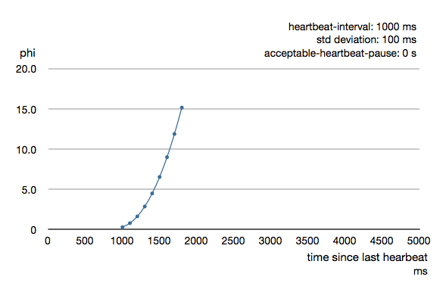
failure detection - phi
Notes:
on the left, the y axis.. we see the value of PHI
on the bottom, the x axis.. we see time since last contact (or heartbeat in this case)..
the way we determine if something is alive, is we pick a value of PHI… say 8 … and that means, that once PHI exceeds that we assume that the thing is dead…
http://doc.akka.io/docs/akka/2.2.0/_images/phi21.png

Slide 258
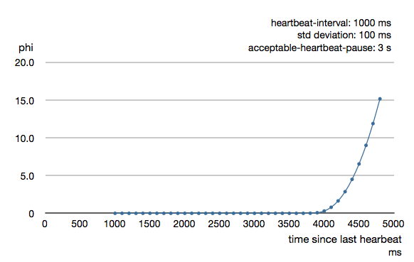
failure detection - phi
Notes:
PHI equation can be parameterized.. so that PHI can be calculated differently depending on the properties of the system it is being used in...
http://doc.akka.io/docs/akka/2.2.0/_images/phi31.png

Slide 259
failure detection - phi
distributed estimation of “liveness”
Notes:
But that’s the main part of it.. by tracking intervals between contacts to a node, we can use phi accrual failure detection to estimate whether or not that thing is alive or not… best of all, we can make this estimate in a fully distributed fashion..

Slide 260
failure detection - phi
we can now detect failures
Notes:
we can now detect failures

Slide 261
failure detection - phi

Slide 262
storing data
Notes:
next, let’s talk about storing data
this particular section will be somewhat of a high level.. but i will use it to introduce a certain type of architecture that lends itself to distributed patterns we’ve described so far..

Slide 263
storing data
Notes:
this will be

Slide 264
storing data
lambda architecture
Notes:
the lambda architecture

Slide 265
storing data - lambda architecture

Slide 266
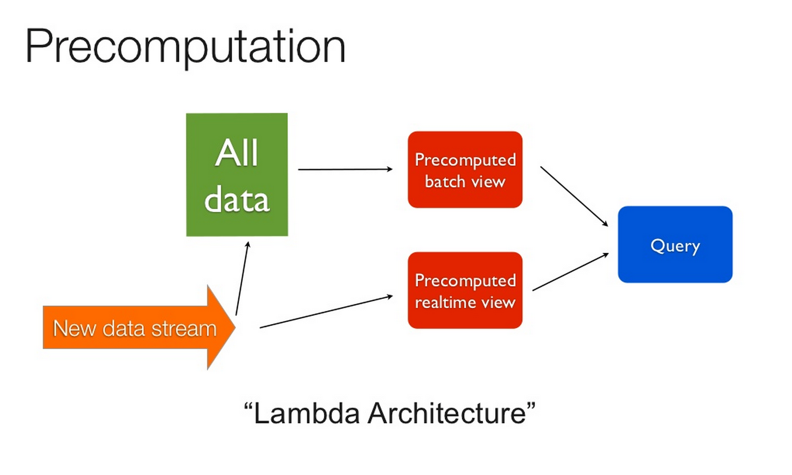
storing data - lambda architecture
Notes:
If you haven’t seen it, Nathan Marz has a fantastic talk about runaway complexity in big data.. his proposed solution is depicted here.. and he calls it “lambda architecture”. I will refer you to his presentation and his book for the details..
the main idea is that your entire distributed system can be thought to serve a purpose.. and that purpose is… given all events that have ever happened.. to compute answers to queries..
the proposed architecture consists of 4 components… the first is “All Data”. Given a new data stream.. All Data will store all data. Every event that happens will be stored in order that All Data sees it. More on this later…
next, the “Precomputed batch view” component will access data from All Data… and .. in batch… precompute answers to queries…
in contrast, the “Precomputed real-time view”, on the bottom there, will precompute answers to queries in real-time feeding off of the new data stream directly…
finally, to serve the purpose of the system… the query component will combine the precomputed batch view with the the precomputed real-time view to present answers desired…
if you squint.. you can probably fit all of the architectures you can think of into this model…
for example.. an app with backed by a single relational database would fit into the “New data stream” -> “Precomputed real-time view” -> “Query” part of the architecture. there is no batch processing, and in essence every new event that comes into the app mutates in real-time the precomputed real-time view, which would be the relational database. then a SQL query would simply parse the precomputed relational view and return it to the user… perhaps doing some more computing in real-time to give the answer…
a Hadoop map reduce framework, on the other hand.. would fit nicely into the top of that architecture diagram.. with All Data being stored in HDFS, Hadoop doing the map reduce work to precompute batch views.. and query component presenting that to the user…
some interesting properties of implementing the entire architecture, is that we can get the best of both worlds… what typically happens, is that the batch workloads are simpler and straightforward, whereas the real-time workloads tend to be more complicated due to real-time requirements for consistency and other concerns.. real-time tends to break easier than scanning batch operations.. as such.. this architecture has the property of being able to deliver real-time information… and that is combined with historical batch information to present a holistic view to the user. however, when real-time pipeline fails.. the batch pipeline will maintain the correct state of the system… and eventually.. as batches catch up and the information presented will reflect the data that real-time pipeline failed to process..
even if the batch pipeline breaks.. it can be recreated from the All Data storage as necessary..
additionally.. we can replay the history of our system in case we need new features or views that we did not anticipate ahead of time
this architecture has all sorts of goodness and i highly recommend you check out Nathan Marz presenting it.. links will be provided at the end..
http://www.slideshare.net/nathanmarz/runaway-complexity-in-big-data-and-a-plan-to-stop-it

Slide 267
storing data - lambda architecture
we can now store data without losing it
Notes:
with that… we can now store data … work on it.. transform it.. without actually risking losing it

Slide 268
storing data - lambda architecture

Slide 269
data reconciliation
Notes:
next, let’s talk about data reconciliation..

Slide 270
data reconciliation

Slide 271
data reconciliation
merkle trees
Notes:
merkle trees.. i promised i’d come back to them, so here they are..

Slide 272
data reconciliation - merkle trees

Slide 273
data reconciliation - merkle trees
154e...
24c7...
843d...
80b6...
5730...
466e...
dd78...
9e4e...
8c11...
62d3...
234e...
df67...
89db...
72dc...
8f63...
32b3...
Notes:
let’s say we have a bunch of data… and we calculate the hashes for the data as illustrated here...

Slide 274
data reconciliation - merkle trees
154e...
24c7...
843d...
80b6...
5730...
466e...
dd78...
9e4e...
8c11...
62d3...
234e...
df67...
89db...
72dc...
8f63...
32b3...
154e...
24c7...
843d...
80b6...
5730...
466e...
93be...
9e4e...
8c11...
9287...
234e...
df67...
89db...
72dc...
8f63...
32b3...
Notes:
then… we do the same on another node.. so that node also has data.. and it calculates hashes for it...

Slide 275
data reconciliation - merkle trees
154e...
24c7...
843d...
80b6...
5730...
466e...
dd78...
9e4e...
8c11...
62d3...
234e...
df67...
89db...
72dc...
8f63...
32b3...
154e...
24c7...
843d...
80b6...
5730...
466e...
93be...
9e4e...
8c11...
9287...
234e...
df67...
89db...
72dc...
8f63...
32b3...
Notes:
highlighted here in red are the differences on the other node from what is stored locally… since all the hashes are the same except data for those two.. we can transfer just the data that does not match the hashes..
ok, but that would suck with large data sets...

Slide 276
data reconciliation - merkle trees
154e...
24c7...
843d...
80b6...
5730...
466e...
dd78...
9e4e...
8c11...
62d3...
234e...
df67...
89db...
72dc...
8f63...
32b3...
154e...
24c7...
843d...
80b6...
5730...
466e...
93be...
9e4e...
8c11...
9287...
234e...
df67...
89db...
72dc...
8f63...
32b3...
277a...
277a...
694b...
2abd...
2abd...
437b...
17c3...
17c3...
Notes:
what merkle trees do.. is hash the hashes.. shown here, we can see that we calculate a new hash level for every 4 lower level hashes..

Slide 277
data reconciliation - merkle trees
154e...
24c7...
843d...
80b6...
5730...
466e...
dd78...
9e4e...
8c11...
62d3...
234e...
df67...
89db...
72dc...
8f63...
32b3...
154e...
24c7...
843d...
80b6...
5730...
466e...
93be...
9e4e...
8c11...
9287...
234e...
df67...
89db...
72dc...
8f63...
32b3...
277a...
277a...
694b...
2abd...
2abd...
437b...
17c3...
17c3...
Notes:
now, we have less information to synchronize because we can compare less hashes than before… instead of 16 pairs to compare, we now have only 4 pairs to compare… and we can then transfer only the relevant parts… digging deeper into the hash levels as necessary to transfer even less information and figure out the exact differences...

Slide 278
data reconciliation - merkle trees
...
...
...
Notes:
this can go on across multiple levels.. to the point where entire data sets can be compared by checking one hash value…

Slide 279
data reconciliation - merkle trees
...
...
...
Notes:
and if that hash value happens to be different.. we can dig deeper into the levels to rapidly target the relevant data that is different and needs to be transfered..

Slide 280
data reconciliation - merkle trees
we can now coordinate our data
Notes:
this is a powerful tool to reduce the volume of the network transfer if that is a concern.. it’s also a rapid way of spotting differences..
we can now coordinate our data

Slide 281
data reconciliation - merkle trees

Slide 282
load balancing
Notes:
lastly.. let’s talk a bit about load balancing…

Slide 283
load balancing

Slide 284
load balancing
Indeed’s Boxcar protocol
Notes:
R.B. from Indeed gave a fantastic presentation on distributed load balancing...

Slide 285
load balancing - Indeed’s Boxcar

Slide 286
load balancing - Indeed’s Boxcar
self-balancing distributed services protocol
Notes:
Indeed’s Boxcar does that..

Slide 287
load balancing - Indeed’s Boxcar
http://www.slideshare.net/indeedeng/indeedeng-boxcar/180
Notes:
It is easier to show you the load balancing in action than to talk about it.. so we go to the source..
http://www.slideshare.net/indeedeng/indeedeng-boxcar/180

Slide 288
load balancing - Indeed’s Boxcar
we can now load balance
Notes:
we can now load balance in a distributed way

Slide 289
load balancing - Indeed’s Boxcar

Slide 290
we can find things
Notes:
to recap, we can find things

Slide 291
we can find things
we can retrieve data
Notes:
we can retrieve data

Slide 292
we can find things
we can retrieve data
we can have global state
Notes:
we can have global state

Slide 293
we can find things
we can retrieve data
we can have global state
we can detect failures
Notes:
we can detect failures

Slide 294
we can find things
we can retrieve data
we can have global state
we can detect failures
we can store data without losing it
Notes:
we can store data without losing it

Slide 295
we can find things
we can retrieve data
we can have global state
we can detect failures
we can store data without losing it
we can coordinate our data
Notes:
we can coordinate our data

Slide 296
we can find things
we can retrieve data
we can have global state
we can detect failures
we can store data without losing it
we can coordinate our data
we can load balance
Notes:
we can load balance

Slide 297
we can find things
we can retrieve data
we can have global state
we can detect failures
we can store data without losing it
we can coordinate our data
we can load balance

Slide 298
what about scale-free composability?
Notes:
so.. i did mention that scale-free composability is the most interesting kind.. but i haven’t demonstrated how to get there with the tools we have..

Slide 299
gossip has some interesting properties
Notes:
to illustrate scale-free composability, first let’s look at some interesting properties of gossip..

Slide 300
Notes:
assume this is a node that knows how to gossip

Slide 301
Notes:
this is a cluster of nodes that know how to gossip with each other

Slide 302
data replication
Notes:
let’s talk data replication..

Slide 303
data replication
Notes:
in a typical fashion, let’s say that we have data that resides on three replicas to handle failure and such
all is well.. we have three replicas.. and we’re gossiping around… etc etc...

Slide 304
data replication
Notes:
let’s now say that we have a network partition.. well, because reality..
so what happens now..

Slide 305
data replication
!
Notes:
if you recall.. gossip and phi accrual failure detection can work hand in hand… and because they are not instantaneous .. one of the nodes is likely to notice something is wrong.
in this case.. a node at the top partition noticed that the it cannot reach 2 out of 3 nodes responsible for orange data… in other words.. in it’s view of the world.. the density of orange data replicas went from 1 to 1/3.

Slide 306
data replication
Notes:
so, it volunteers to be an orange data replica…

Slide 307
data replication
Notes:
this situation is better.. but the densities are still below the expected...

Slide 308
data replication
!
!
Notes:
two other node in each partition notice the incorrect density..

Slide 309
data replication
Notes:
they volunteer to be orange data replicas

Slide 310
data replication
Notes:
and now.. each partition has the correct number of replicas as expected..

Slide 311
data replication
Notes:
if the partition is restored..

Slide 312
data replication
!
!
Notes:
orange data node will become aware that there are too many orange data replicas..

Slide 313
data replication
!
!
Notes:
and will start pruning...

Slide 314
data replication
!
!

Slide 315
data replication

Slide 316
data replication
!

Slide 317
data replication
!

Slide 318
data replication
!

Slide 319
data replication
Notes:
until the density is as expected…

Slide 320
auto-scaling
Notes:
another example.. auto-scaling

Slide 321
auto-scaling
Notes:
let’s say that some blue overloaded property is triggered on a node

Slide 322
auto-scaling
Notes:
more blue overload is triggered

Slide 323
auto-scaling

Slide 324
auto-scaling

Slide 325
auto-scaling
Notes:
until most nodes are overloaded..

Slide 326
auto-scaling
Notes:
the last node becomes overloaded

Slide 327
auto-scaling
Notes:
and as such.. it notices that the overload density reached a 100% saturation and new nodes need to be created

Slide 328
auto-scaling
Notes:
this temporarily relieves the load

Slide 329
auto-scaling

Slide 330
auto-scaling
Notes:
until we are overloaded again

Slide 331
auto-scaling

Slide 332
auto-scaling
Notes:
adding another node..

Slide 333
auto-scaling

Slide 334
auto-scaling
Notes:
and this could have gotten us past the overloaded condition

Slide 335
auto-scaling

Slide 336
auto-scaling
Notes:
as the density is reduced.. another threshold is passed..

Slide 337
auto-scaling

Slide 338
auto-scaling
!
Notes:
this time.. the last node notices that there is excess capacity for the conditions..

Slide 339
auto-scaling
!
Notes:
so it starts pruning

Slide 340
auto-scaling
!

Slide 341
auto-scaling
Notes:
and balance is restored again..

Slide 342
with gossip, we can make decisions based on density and “liveness”
Notes:
the interesting thing with gossip and failure detection is that we can make decisions based on density and “liveness”

Slide 343
ok, but scale-free...
Notes:
so, keeping that in mind...

Slide 344
clusters of clusters
Notes:
can we build cluster of clusters?
so far… all the nodes saw and talked to each other..

Slide 345
clusters of clusters
Notes:
however, we can actually have separate clusters that don’t readily see each other

Slide 346
clusters of clusters

Slide 347
clusters of clusters

Slide 348
clusters of clusters

Slide 349
clusters of clusters
Notes:
each of these can be an isolated cluster.. they can then use density and “liveness” to select nodes that should do inter-cluster communication as necessary.. thus turning themselves into a super-node of sorts..

Slide 350
clusters of clusters

Slide 351
clusters of clusters

Slide 352
clusters of clusters

Slide 353
clusters of clusters

Slide 354
clusters of clusters
Notes:
these clusters can now implement gossip and liveness detection with each other..

Slide 355
clusters of clusters

Slide 356
clusters of clusters

Slide 357
clusters of clusters

Slide 358
clusters of clusters
and so on...
Notes:
and thus it seems we can build a scale-free system on gossip and failure detection alone.. the other patterns are useful because we want everything to be decentralized

Slide 359
clusters of clusters

Slide 360
putting it all together...
Notes:
i’ve shown you pieces so far.. but can we actually do something with all these decentralized patterns?

Slide 361
alldata
Notes:
yes we can

Slide 362
alldata

Slide 363
alldata
Notes:
alldata is a project that implements the “All data” part of Lambda Architecture

Slide 364
alldata
20130927T005240652508858176
Notes:
to recap.. all data stores events… each of these events have a key, which is a unique timestamp of when the system saw the event first…

Slide 365
alldata
20130927T005240652508858176
20130927T005241737219927381
Notes:
next event.. next key..

Slide 366
alldata
20130927T005240652508858176
20130927T005241737219927381
20130927T005242771277348382
20130927T005242349865651023
...
Notes:
and so on… we build up a list of events that happened according to the all data system ordering

Slide 367
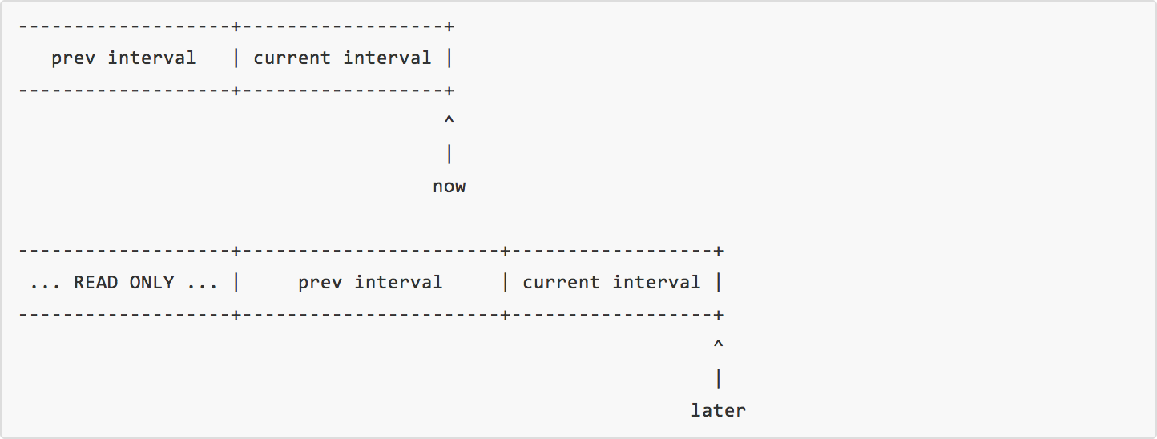
alldata
Notes:
we can divide all these events into time intervals… let’s say.. 5 minute intervals… every event will have a timestamp…
because we will replicate the events for durability… the clocks on any one node can drift… so maybe we can expect a replica to be written from a node that assigned a timestamp in our past.. but we can put a bound on this.. say we don’t expect things to be given to us older than 10 mintues..
illustrated here.. we show how these time intervals progres… the current interval is the local now… we are always correct.. however, if we get replicas from other nodes… the timestamps on those might be different.. so we allow a previous interval to also be written.
however.. after a certain time window.. we declare an interval READ ONLY and any replica attempt to write into that interval will result in an error

Slide 368
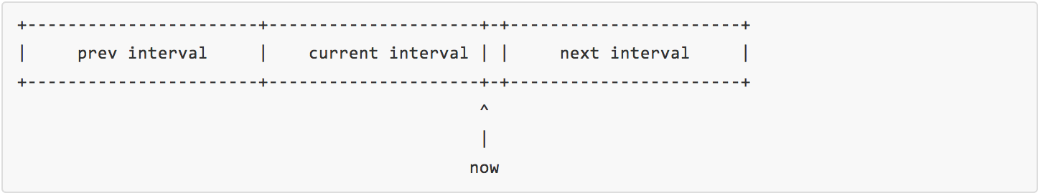
alldata
Notes:
additionally… for the same reason.. we might get a replica request in the future.. so we allow a future interval to be written as well.. either way.. over time.. new intervals are created and the older intervals become read-only

Slide 369
alldata
writes
Notes:
how alldata handles writing new events

Slide 370
alldata - writes

Slide 371
alldata - writes
Notes:
assume we have 15 nodes up

Slide 372
alldata - writes
Notes:
and these are organized 3 per zone

Slide 373
alldata - writes
Notes:
and let’s say that 3 of the zones on the left belong to the left region.. and 2 of the zones on the right belong to the right region

Slide 374
alldata - writes
Notes:
a write comes in to a random node...

Slide 375
alldata - writes
Notes:
that node becomes a coordinator.. writes the event locally...

Slide 376
alldata - writes
Notes:
and selects a node to replicate the data to according to replication strategy...

Slide 377
alldata - writes
Notes:
once the replicas are acknowledged according to replication strategy… the node acknowledges that the alldata system has stored the event..

Slide 378
alldata - writes

Slide 379
alldata - consolidation
Notes:
let’s talk about consolidation… as i mentioned before… after a while.. intervals become read-only..

Slide 380
alldata - consolidation
Notes:
here we have some interval becoming read-only on two nodes..

Slide 381
alldata - consolidation
Notes:
more nodes close the interval

Slide 382
alldata - consolidation
Notes:
all but one closed

Slide 383
alldata - consolidation
Notes:
when the final node closes the interval… the density of intervals closed reaches 100% saturation..

Slide 384
alldata - consolidation
Notes:
this triggers the node to become a consolidator and volunteer to hold all the data for that particular interval...

Slide 385
alldata - consolidation
Notes:
it starts collecting data from other nodes.. remember merkle-trees? it tries to copy only what it doesn’t have...

Slide 386
alldata - consolidation
Notes:
another node notices that every node closed the yellow interval.. but that there isn’t enough consolidators in the cluster… so it volunteers to become one..

Slide 387
alldata - consolidation
Notes:
and it starts to gather data as well (for this example.. we will only have 2 final replicas)

Slide 388
alldata - consolidation
Notes:
the consolidators consolidate the data..

Slide 389
alldata - consolidation
Notes:
after they received data from every peer the can see…

Slide 390
alldata - consolidation
Notes:
the consolidate data with other consolidators to make sure they have everything...

Slide 391
alldata - consolidation
Notes:
once they agree they have the same data… the go into a “consolidated state”

Slide 392
alldata - consolidation
Notes:
other nodes start to notice that the yellow interval has been consolidated and that the required number of replicas already exists…. they start to prune the data corresponding to the yellow interval...

Slide 393
alldata - consolidation
Notes:
pruning continues

Slide 394
alldata - consolidation
Notes:
until the data now rests on the desired number of replicas…

Slide 395
alldata - consolidation + discovery
Notes:
as soon as consolidation is complete…. at the same time that pruning takes place… the nodes announce to via the discovery mechanism that they are the ones holding the replicas for that particular interval..
when this announcement is stored in the discovery DHT, the replicas are now ready to handle the batch precomputation requests by the batch portion of the lambda architecture.

Slide 396
alldata - repair
Notes:
as i illustrated before… repair is handled in a distributed manner

Slide 397
alldata - repair
Notes:
let’s say that a consolidated replica fails

Slide 398
alldata - repair

Slide 399
alldata - repair
!
Notes:
another node notices that the density required for that particular replica dropped below a threshold…

Slide 400
alldata - repair
!
Notes:
the node volunteers to become a new consolidated replica

Slide 401
alldata - repair
Notes:
it contacts the existing replica and copies the data...

Slide 402
alldata - repair

Slide 403
alldata - repair

Slide 404
alldata - repair + discovery
Notes:
when copying is complete.. it announces itself to the discovery DHT that it is now responsible for a replica of that particular interval

Slide 405
alldata - resilience
Notes:
at the same time that is happening…

Slide 406
alldata - resilience
Notes:
a node notices that the desired density in the zone has been reduced… it creates a new node to replace the lost one

Slide 407
alldata - resilience
Notes:
and all is well

Slide 408
alldata - retirement
Notes:
at some point nodes will fill up with data...

Slide 409
alldata - retirement
FULL
Notes:
when a node becomes full, it can no longer handle additional data

Slide 410
alldata - retirement

Slide 411
alldata - retirement
Notes:
at that point.. it removes itself from the writeable cluster and enters a read only mode

Slide 412
alldata - retirement
READ-ONLY

Slide 413
alldata - retirement
Notes:
however.. while it is no longer part of the writeable cluster.. it still is a part of the read cluster along with the non-full node that has a replica of the same interval..

Slide 414
alldata - retirement + resilience
Notes:
the resilience part of the system kicks in as before and notices that node density in the zone fell below a threshold

Slide 415
alldata - retirement + resilience
Notes:
a new node is created

Slide 416
alldata - retirement + resilience
Notes:
and the system continues...

Slide 417
alldata
Notes:
so, that is one illustration of how these distributed patterns can be used to create distributed systems that do something useful…
but that is not the most interesting part…
i want to leave you with one parting thought...

Slide 418
WebRTC
Notes:
WebRTC is all the rage nowadays as it is becoming more and more useful...

Slide 419
WebRTC

Slide 420

WebRTC
Notes:
so, consider that we have a web browser with no server backing it...
http://www.clker.com/cliparts/d/1/5/b/1347395659328972204Portable%20Laptop.svg.thumb.png

Slide 421
WebRTC
Notes:
we now have an application in the browser.. and WebRTC allows us to establish direct connections between browsers…
Paul’s Grimwire enables that, for example..
http://www.clker.com/cliparts/d/1/5/b/1347395659328972204Portable%20Laptop.svg.thumb.png

Slide 422
WebRTC
we can find things
we can retrieve data
we can have global state
we can detect failures
we can store data without losing it
we can coordinate our data
we can load balance
Notes:
Hopefully I’ve demonstrated that we can do all these things in a distributed fashion…
we can find things, retrieve data, have global state, detect failures, store data without losing it, coordinate our data, and load balance…
we can also do other things that I had to cut out of the presentation, but there’s even more :)

Slide 423
WebRTC
REMINDER:
you may find yourself wondering what this has to do with JavaScript…
all of what follows has been implemented in JavaScript
these are tools YOU can use tomorrow
Notes:
and remember.. all this has been already implemented in JavaScript… you can use these things tomorrow.. or tonight for that matter

Slide 424
WebRTC
The future is already here…
it’s just not very evenly distributed.
-- William Gibson
Notes:
so… i hope that you will give this some thought.. and the next time you’re thinking of building something… instead of thinking as to why you should build a distributed system… perhaps instead you’ll answer “why not?”

Slide 425
References and Resources:
discovery and DHTs: https://github.com/tristanls/discover, http://maude.sip.ucm.es/kademlia/files/pita_kademlia.pdf,
pulling data, DHTs, and BitTorrent: https://peercdn.com/, https://github.com/peers/peerjs, https://github.com/PeerCDN,
pushing data, gossip: https://github.com/tristanls/gossipmonger, http://www.cs.cornell.edu/home/rvr/papers/flowgossip.pdf,
failure detection, gossip, phi: http://ddg.jaist.ac.jp/pub/HDY+04.pdf, https://github.com/tristanls/gossipmonger-peer,
storing data, lambda architecture: http://www.infoq.com/presentations/Complexity-Big-Data, http://www.slideshare.net/nathanmarz/runaway-complexity-in-big-data-and-a-plan-to-stop-it, https://github.com/tristanls/alldata,
data reconciliation, merkle trees: https://github.com/dominictarr/scuttlebutt, https://github.com/c-geek/merkle,
load balancing, Indeed’s Boxcar: https://engineering.indeed.com/blog/2013/11/indeedeng-boxcar-a-self-balancing-distributed-services-protocol-slides-video/, https://github.com/tristanls/callosum,
WebRTC, browser peer-to-peer: https://github.com/grimwire, http://www.html5rocks.com/en/tutorials/webrtc/infrastructure/, http://webrtc.googlecode.com/svn/trunk/samples/js/demos/html/dc1.html, http://chimera.labs.oreilly.com/books/1230000000545,
distributed things in JavaScript: https://github.com/dominictarr, https://github.com/level
object capabilities and web-keys: http://waterken.sourceforge.net/web-key/, http://www.erights.org/elib/capability/index.html,
Ken protocol: https://www.usenix.org/system/files/conference/atc12/atc12-final206-7-20-12.pdf,
*sources for images are included on the slide notes on which they appear
Notes:
here are references and resources to look into if you found this interesting
i’ll be posting the slides online so these will be available later...

Slide 426
@tristanls
Notes:
once again, I am Tristan Slominski and can be found as @tristanls on most things…
what are your questions?

